Slide 1
Microsoft Defender for Cloud + Azure Sentinel - Better Together! Day 1

Slide 2
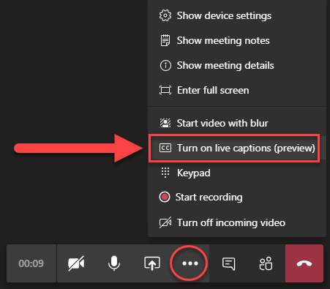
Get Ready!
Set up a place to take notes
Make sure you have something hydrating
Turn on live captions
Find your favorite gif
Need help? Drop a message in the chat window so our team can assist!
Ellipsis

Slide 3



Meet Your Coaches
Ben Stegink
Chris Givens

Slide 4
Announcements
We are recording
Need help?
Stepping away?
Share feedback
All presentations are being recorded and will be shared out in the General Channel.
When ready, our team will post an announcement letting you know they have posted.
Tag our team in the chat anywhere in the event Teams site and we’ll be right there to assist.
People who can help:
Chris Givens
Ben Stegink
Andrea Racine
James Grenz
That’s okay! We all need to step away sometimes for a few minutes.
All we ask is that you let our team know when you do.
This is a pilot, so we need your help!
At the end of today during closing we will share an anonymous survey.
Please be honest and let us know what went great and what could go better.

Slide 5
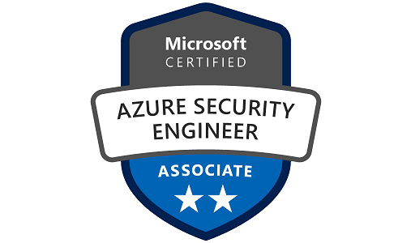
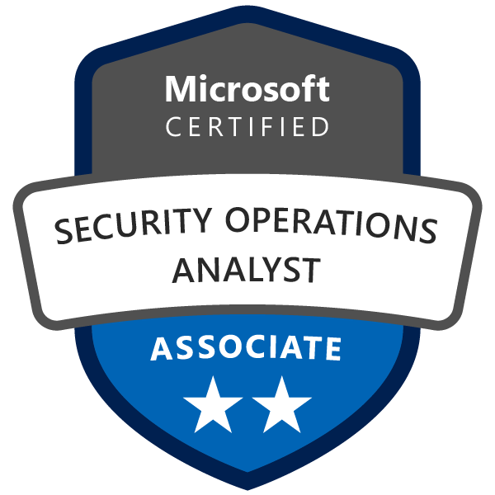
Prerequisite Knowledge
AZ-500 - Microsoft Azure Security Technologies
https://query.prod.cms.rt.microsoft.com/cms/api/am/binary/RE3VC70
SC-200 - Microsoft Security Operations Analyst
https://query.prod.cms.rt.microsoft.com/cms/api/am/binary/RE4Myp3

Slide 6
A look into Day 1
Kick-Off | 8:00-8:05 | Welcome | Main Call
 | 8:05-8:30 | Microsoft Defender for Cloud
 | 8:30-8:45 | Demo Walkthrough
High-Level | 8:45-9:00 | Break
 | 9:00-10:15 | Microsoft Defender for Cloud (Advanced) Part I
 | 10:15-10:30 | Break
 | 10:30-11:00 | Activity: Microsoft Defender for Cloud Solutions | Table Group Call
 | 11:00-12:00 | Build Hands-on: Microsoft Defender for Cloud Part I
Getting Technical | 12:00-1:00 | Long Break | Main Call
 | 1:00-1:30 | Microsoft Defender for Cloud (Advanced) Part II
 | 1:30-2:15 | Azure Sentinel
 | 2:15-2:45 | Activity: Azure Sentinel | Table Group Call
 | 2:45-4:00 | Build Hands-on: Microsoft Defender for Cloud APIs, Azure Sentinel | Table Group Call
 | 4:00-4:15 | Closing | Main Call
Today we will be learning and collaborating across three spaces:
Main call (this meeting)
Table Group channel within the event Team
CloudLabs Learner Portal & Lab environment
Presentation/
Whole Group
Lab
Activity/ Discussion/ Group Work
Announcements

Slide 7
Microsoft Defender for Cloud + Azure Sentinel : Better Together
The next two days will focus on how Microsoft Defender for Cloud and Azure Sentinel through working together using other underlying products protect a customer’s infrastructure and business from threats.
Day 1:
A look at Microsoft Defender for Cloud (Deployment, APIs, KQL) with activities and labs
A look at Azure Sentinel with activities and labs, specifically how to migrate from other SIEM systems.
Day 2:
How Microsoft Defender for Cloud and Azure Sentinel utilize Log Analytics + Azure Automation to implement a highly efficient Security Operations Center with activities and labs.
Highlight: Respond to a real attack.

Slide 8
Microsoft Defender for Cloud + Azure Sentinel

Slide 9
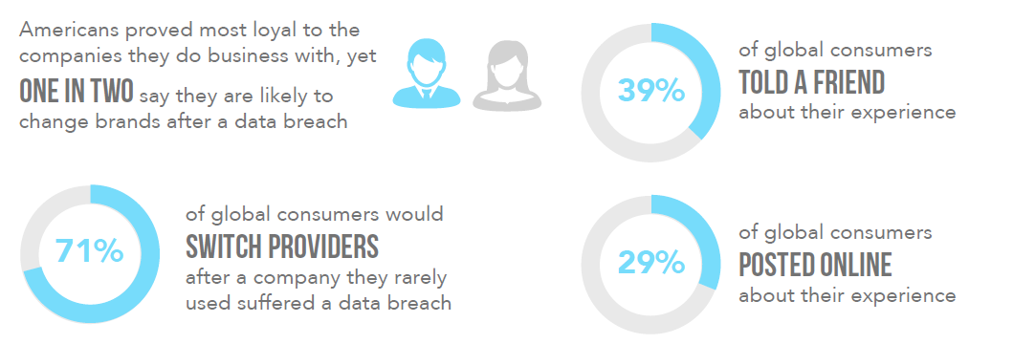
Why are we here?
Of all the major costs and risks associated with managing a security incident, the potential hit to brand and reputation and loss of customer trust could be the most damaging.

Slide 10
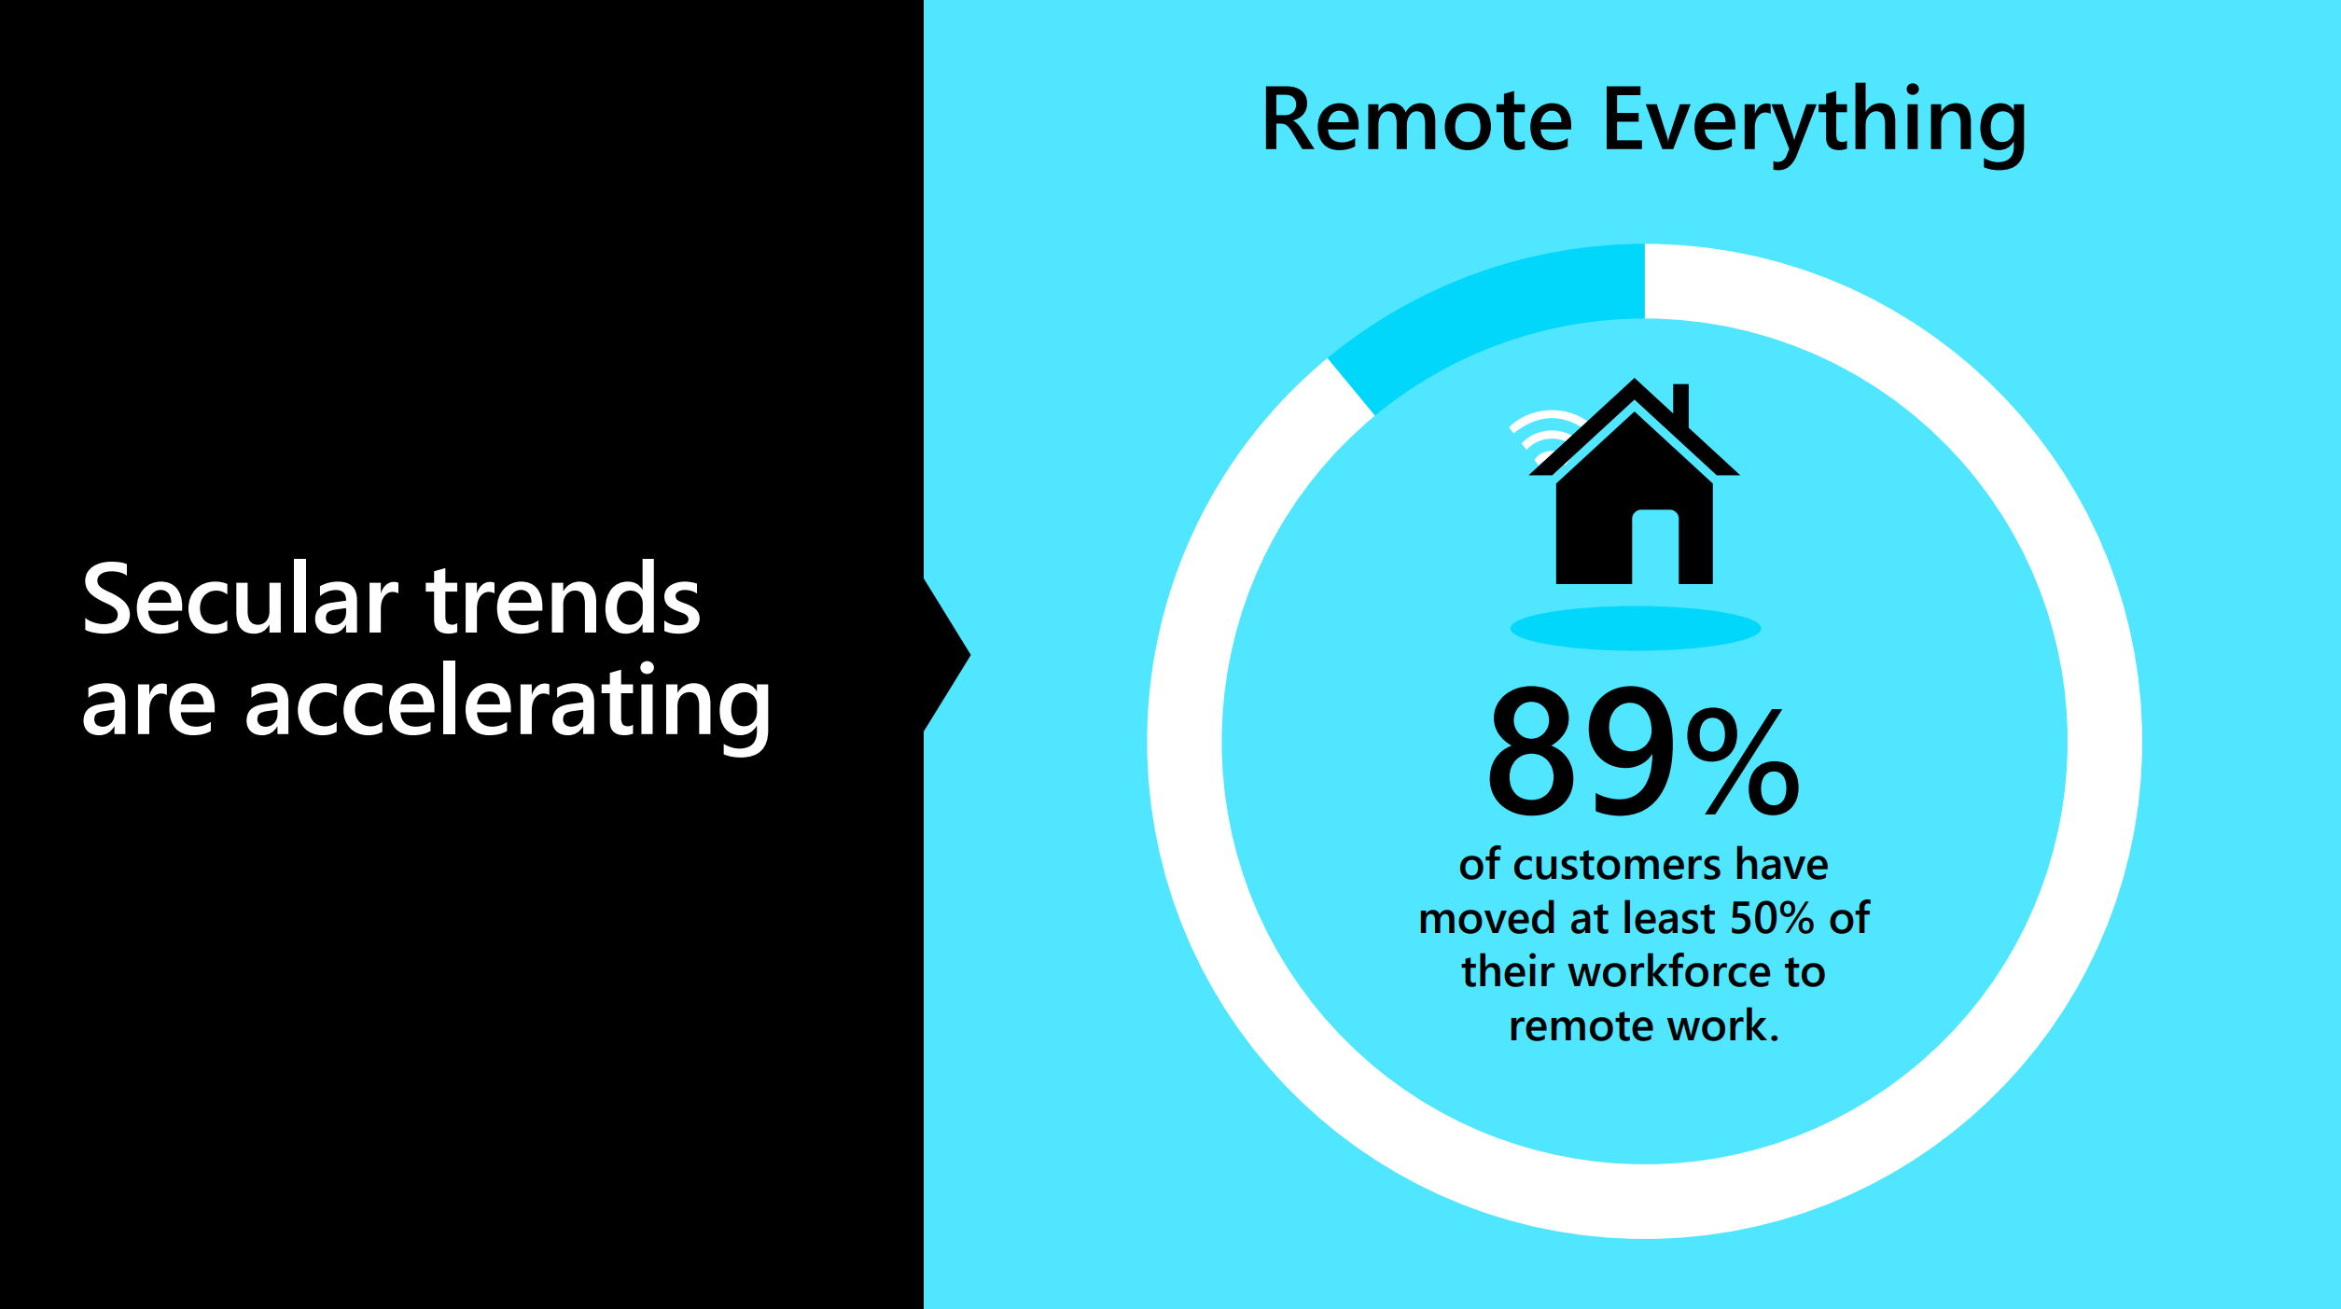

Slide 11
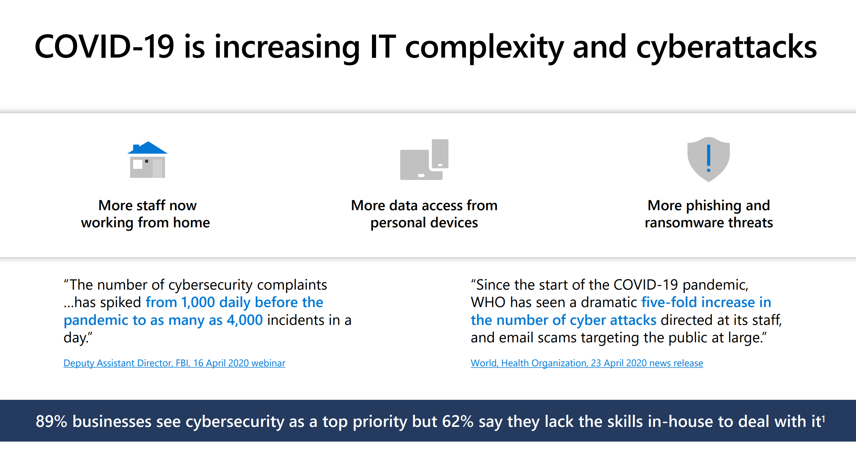

Slide 12
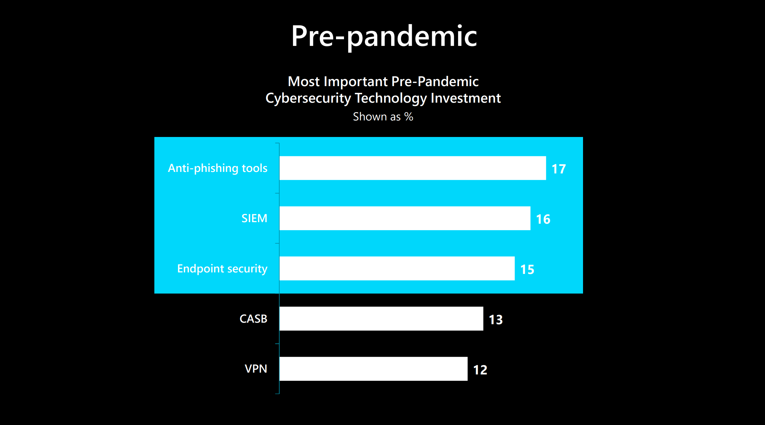

Slide 13
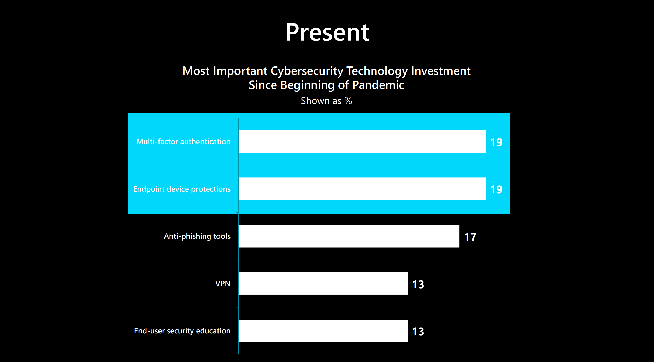

Slide 14
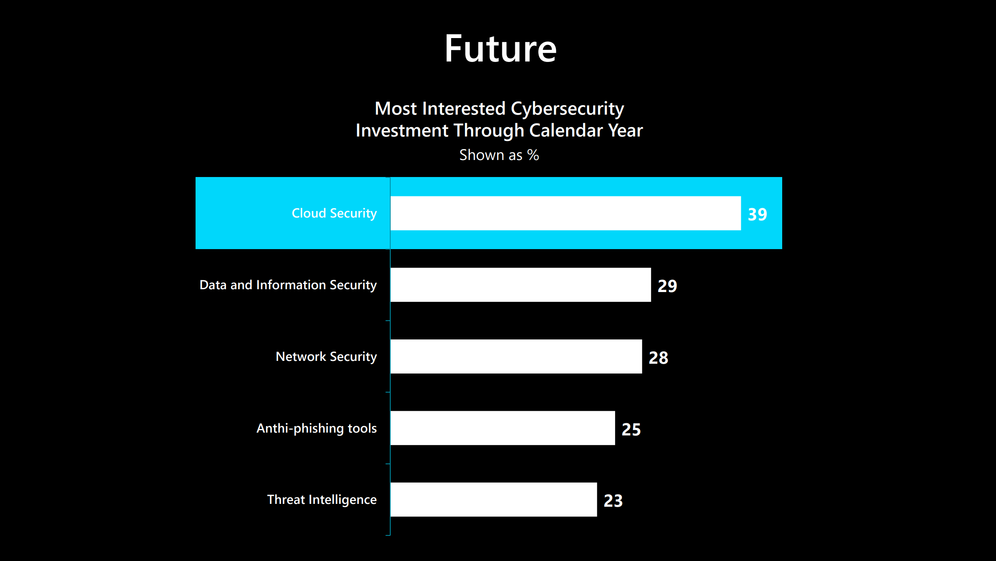

Slide 15
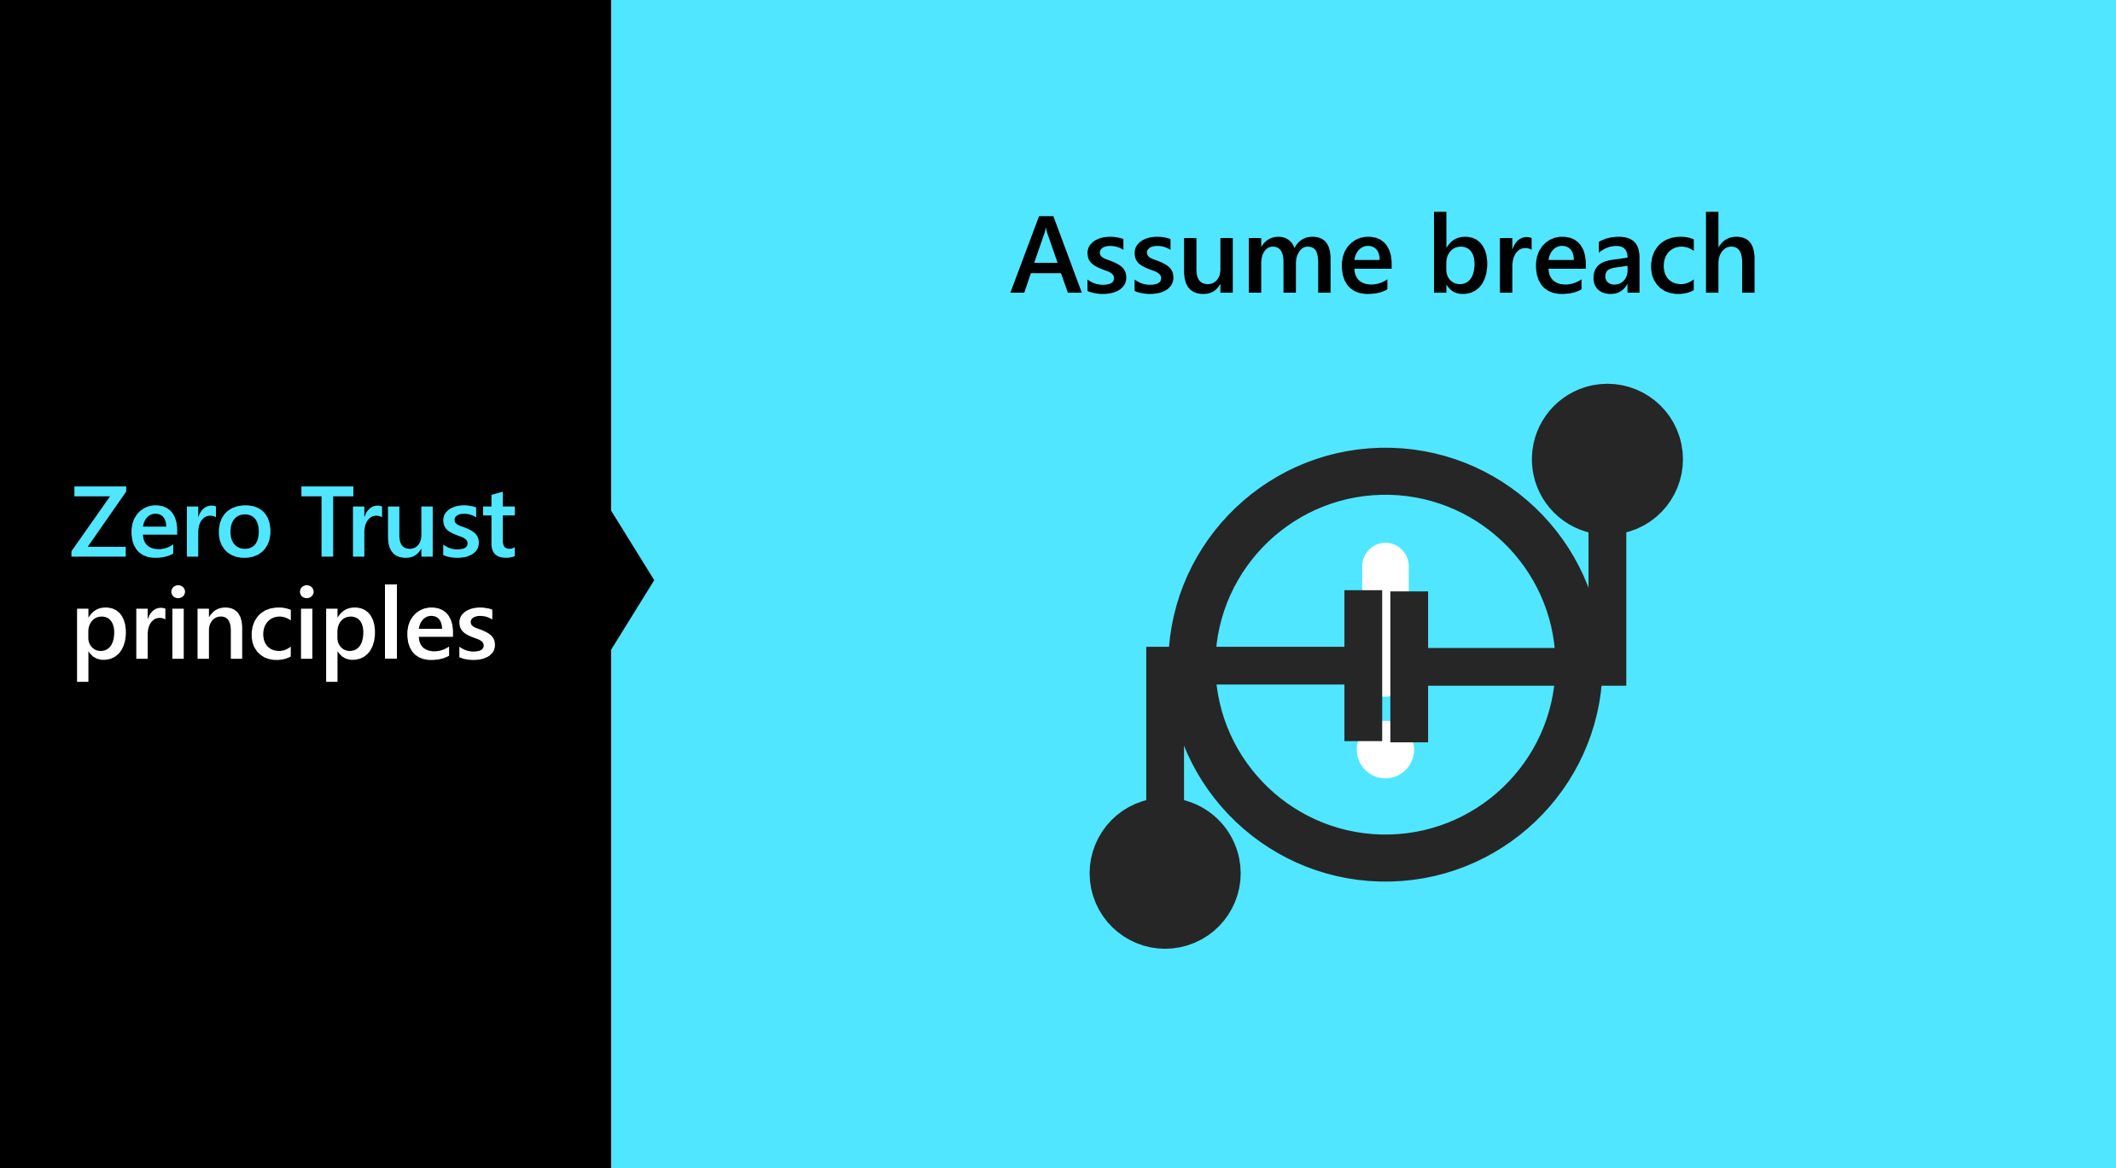

Slide 16
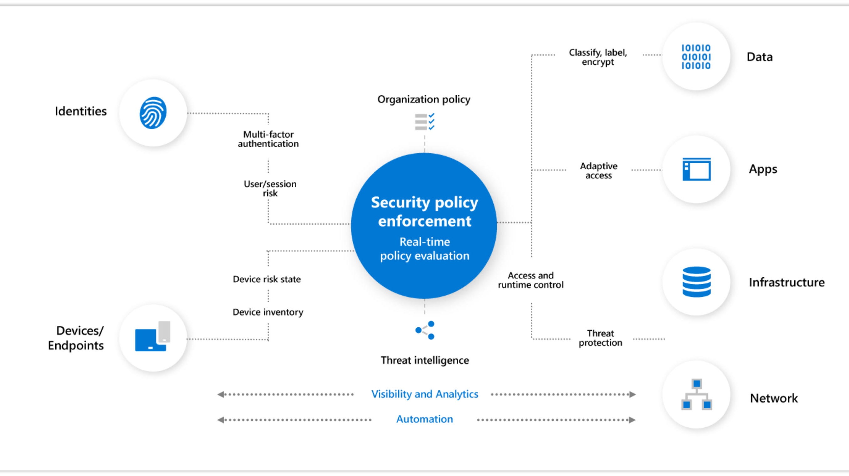

Slide 17
Microsoft Defender for Cloud / Azure Sentinel – Advanced Demo

Slide 18
Thank You slide
Break (15 mins)

Slide 19
Microsoft Defender for Cloud

Slide 20
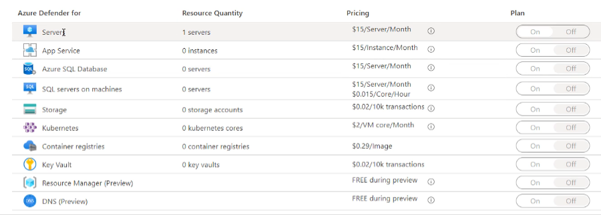
Microsoft Defender for Cloud
Paid option
VM Vulnerability Assessment
Just in Time VM Access
Adaptive Application Control
Container Image Scanning
Adaptive Network Hardening
SQL Vulnerability Assessment
File Integrity Monitoring
Network Mapping
IoT Security

Slide 21
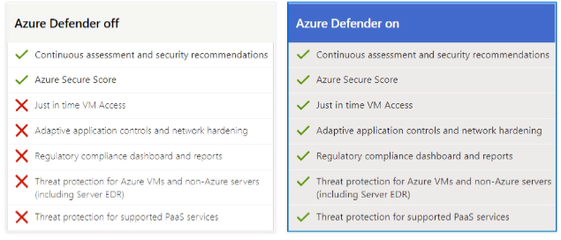
Microsoft Defender for Cloud

Slide 22
CSPM Philosophy
Cloud Security Posture Management
Considering Zero Trust Security Model
Considering App Risk Scores
Considering TVM (Threat & Vulnerability Management) for totality of the entire attack Service
Considering the Threat Model Tool

Slide 23
Microsoft Defender for Cloud Deployment

Slide 24
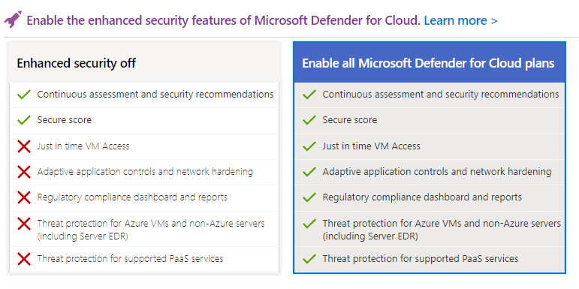
Microsoft Defender for Cloud Deployment
You can automate the enabling of Microsoft Defender for Cloud protections using the Azure PowerShell commandlets.

Slide 25
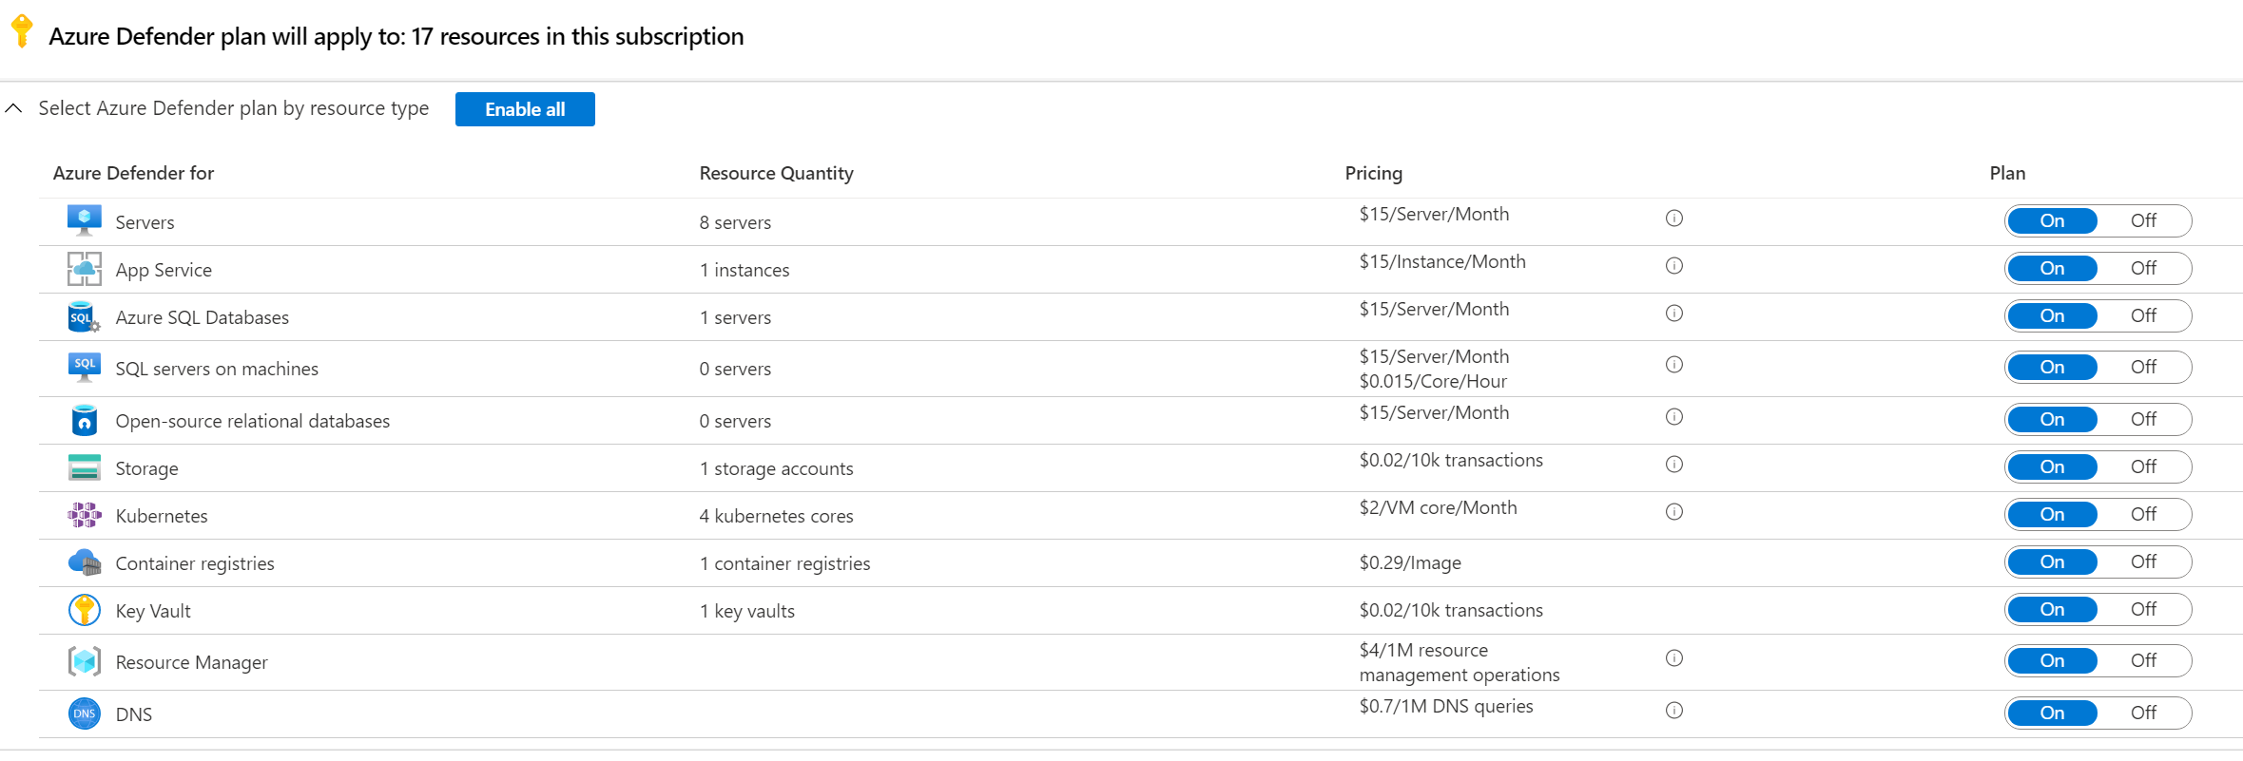
PowerShell (Resources Enable)
Register-AzResourceProvider -ProviderNamespace 'Microsoft.Security'
$Resources = Get-AzSecurityPricing | Select-Object Name
foreach ($resource in $Resources)
{
Set-AzSecurityPricing -Name $resource.name -PricingTier "Standard"
}

Slide 26
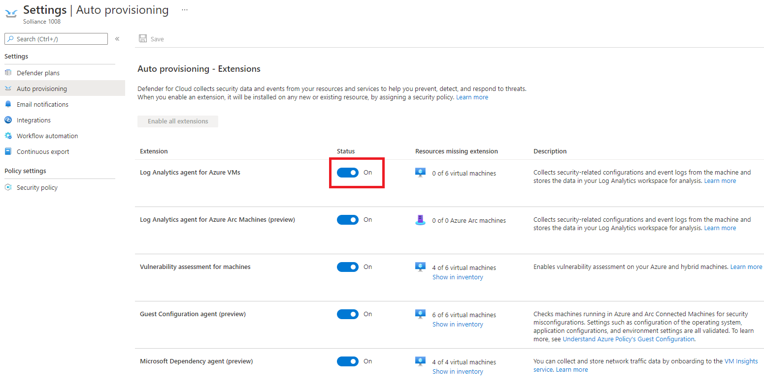
PowerShell (Agent Auto Deployment)
Set-AzSecurityAutoProvisioningSetting -Name "default" -EnableAutoProvision

Slide 27
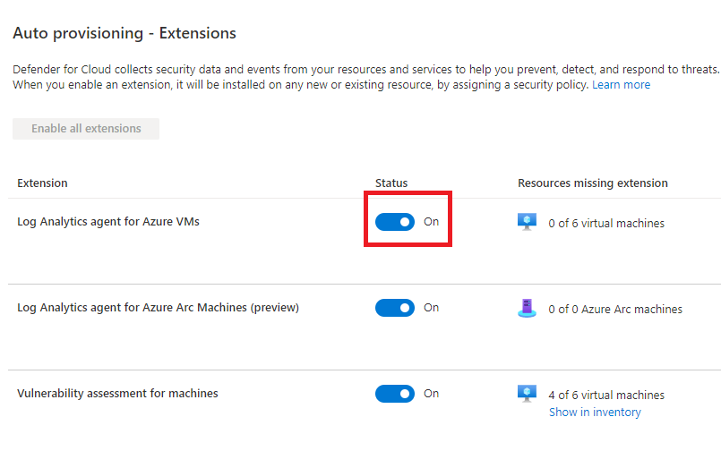
Quick Note
If you enable auto deployment, the Log Analytics workspace will be the default one for Microsoft Defender for Cloud
You will have to reconfigure the Microsoft Monitoring Agent to point to a custom Log Analytics workspace.
This would be to enable things like Change Tracking, etc.

Slide 28
PowerShell (Dependency Agent Auto Deployment)
#azure dependency agent for linux
$def2 = Get-AzPolicyDefinition -Id "/providers/Microsoft.Authorization/policyDefinitions/4da21710-ce6f-4e06-8cdb-5cc4c93ffbee"
#azure dependency agent for windows
$def3 = Get-AzPolicyDefinition -Id "/providers/Microsoft.Authorization/policyDefinitions/1c210e94-a481-4beb-95fa-1571b434fb04"
$assign = New-AzPolicyAssignment -Name "ASC provisioning Dependency agent for Linux" -Description "This policy assignment was automatically created by Azure Security Center for agent installation as configured in Security Center auto provisioning." -PolicyDefinition $def2 -Scope "/subscriptions/$SubscriptionId" -AssignIdentity -Location 'Central US' #$rg.location
$assign | Set-AzPolicyAssignment -EnforcementMode Default;
$assign = New-AzPolicyAssignment -Name "ASC provisioning Dependency agent for Windows" -Description "This policy assignment was automatically created by Azure Security Center for agent installation as configured in Security Center auto provisioning." -PolicyDefinition $def3 -Scope "/subscriptions/$SubscriptionId" -AssignIdentity -Location 'Central US' #$rg.location
$assign | Set-AzPolicyAssignment -EnforcementMode Default;

Slide 29
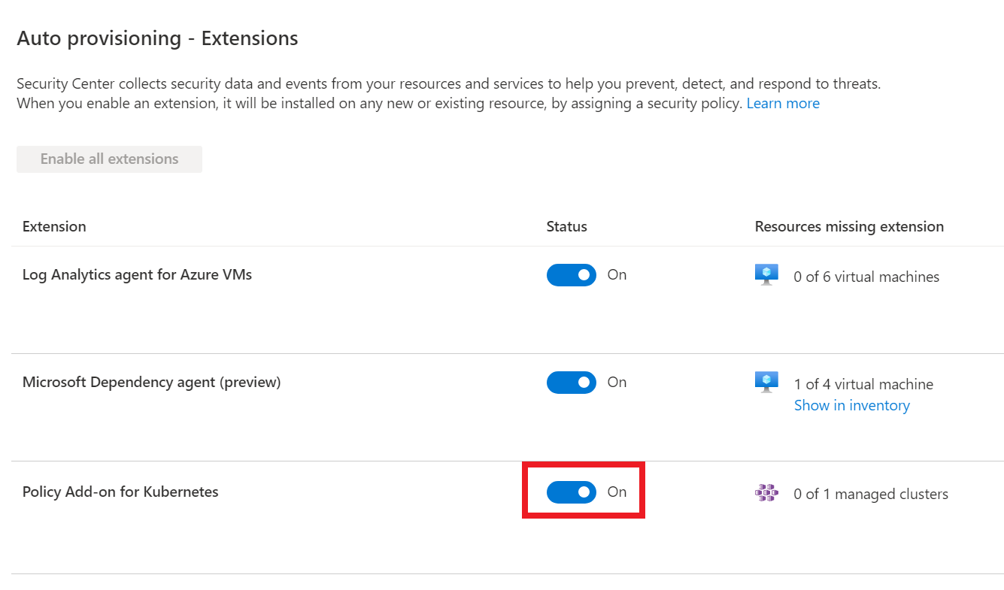
PowerShell (AKS Policy)
#azure policy for kubernetes
$def1 = Get-AzPolicyDefinition -Id "/providers/Microsoft.Authorization/policyDefinitions/a8eff44f-8c92-45c3-a3fb-9880802d67a7"
$scope = "/subscriptions/$subscriptionId";
$assign = New-AzPolicyAssignment -Name "ASC provisioning Azure Policy Addon for Kubernetes" -Description "This policy assignment was automatically created by Azure Security Center for agent installation as configured in Security Center auto provisioning." -PolicyDefinition $def1 -Scope "/subscriptions/$SubscriptionId" -AssignIdentity -Location 'Central US' #$rg.location
$assign | Set-AzPolicyAssignment -EnforcementMode Default;

Slide 30
Microsoft Defender for Cloud – Workload Protections

Slide 31

Agenda
1 Microsoft Defender for Cloud Workload Protections
VM+SQL Vulnerability
File Integrity
Container Image Scanning
Adaptive Application Control
Adaptive Network Hardening
JIT VM Access
Network Map
IoT Security

Slide 32
Azure Policy
Notes:
Back to me

Slide 33

Azure Policy
Azure Policy helps to enforce organizational standards and to assess compliance at-scale. Through its compliance dashboard, it provides an aggregated view to evaluate the overall state of the environment, with the ability to drill down to the per-resource, per-policy granularity. It also helps to bring your resources to compliance through bulk remediation for existing resources and automatic remediation for new resources.
Common use cases for Azure Policy include implementing governance for resource consistency, regulatory compliance, security, cost, and management.

Slide 34
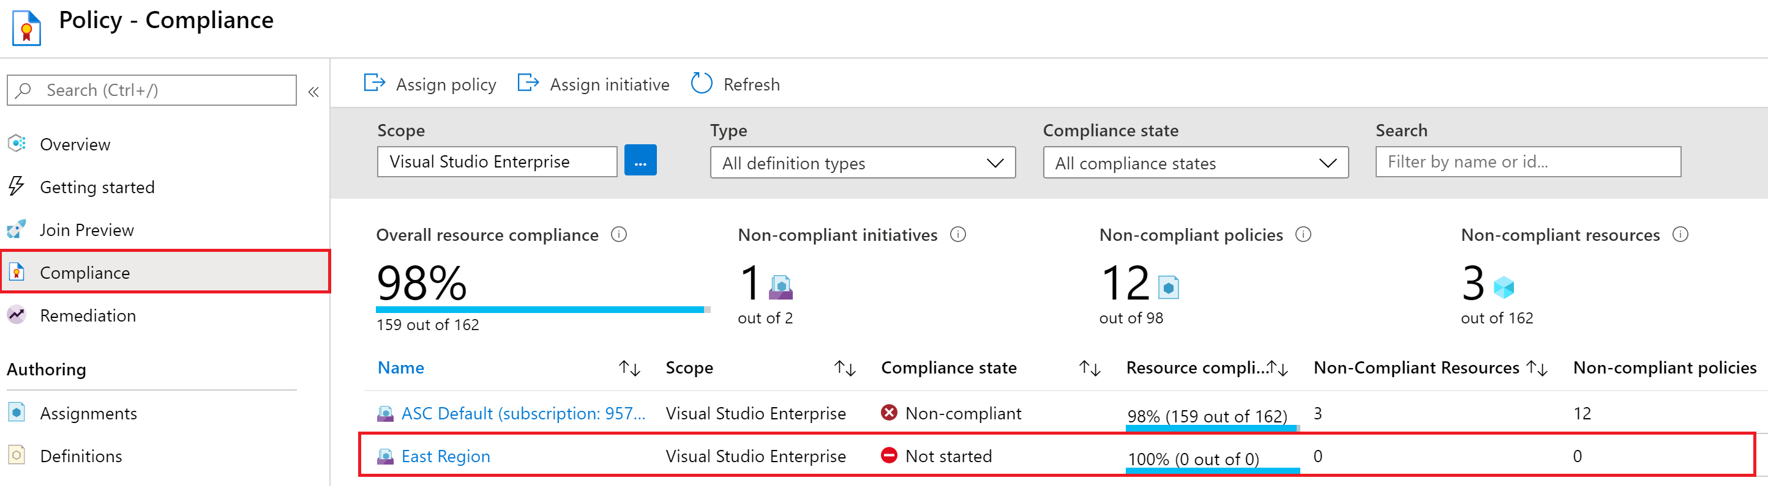
Microsoft Defender for Cloud + Azure Policy
Many of the control plane protections in Microsoft Defender for Cloud utilize Azure Policy for evaluated resources or applying compliance standards. Microsoft Defender for Cloud Policies are stored in the ASC Default policy.

Slide 35
Microsoft Defender for Cloud + Azure Policy
As we discuss each Microsoft Defender for Cloud feature, we will review the Azure Policy items that map to those features.
Some features will not contain or reference Azure Policy elements.

Slide 36
Deployment
As we discuss each Microsoft Defender for Cloud feature, we will review the deployment methods for those features.
Most will be driven by PowerShell cmdlets, some will need to call REST endpoints, others may need to call the Azure Resource Graph API.
In some cases, you’ll need to use other resource REST APIs to gain access to the artifacts that are generated by Microsoft Defender for Cloud features.

Slide 37
Deployment (Compliance)
Utilize Azure Portal or REST API to remove exclusions.
https://management.azure.com/subscriptions/$subscriptionId/providers/Microsoft.Authorization/policyAssignments/SecurityCenterBuiltIn?api-version=2019-09-01
"excludedOutOfTheBoxStandards":["SOC TSP","Azure Security Benchmark","PCI DSS 3.2.1","ISO 27001"]
Set to an empty array to allow all standard to display

Slide 38
VM Vulnerability Assessments

Slide 39
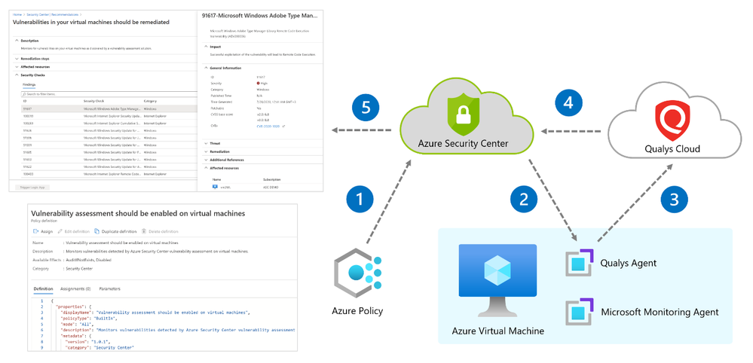
Microsoft Defender for Cloud – VM Vulnerability Assessment
Microsoft Defender for Cloud includes vulnerability scanning for your machines at no extra cost.
Microsoft Defender for Cloud's integrated vulnerability assessment solution works seamlessly with Azure Arc. When you've deployed Azure Arc, your machines will appear in Microsoft Defender for Cloud and no Log Analytics agent is required.

Slide 40
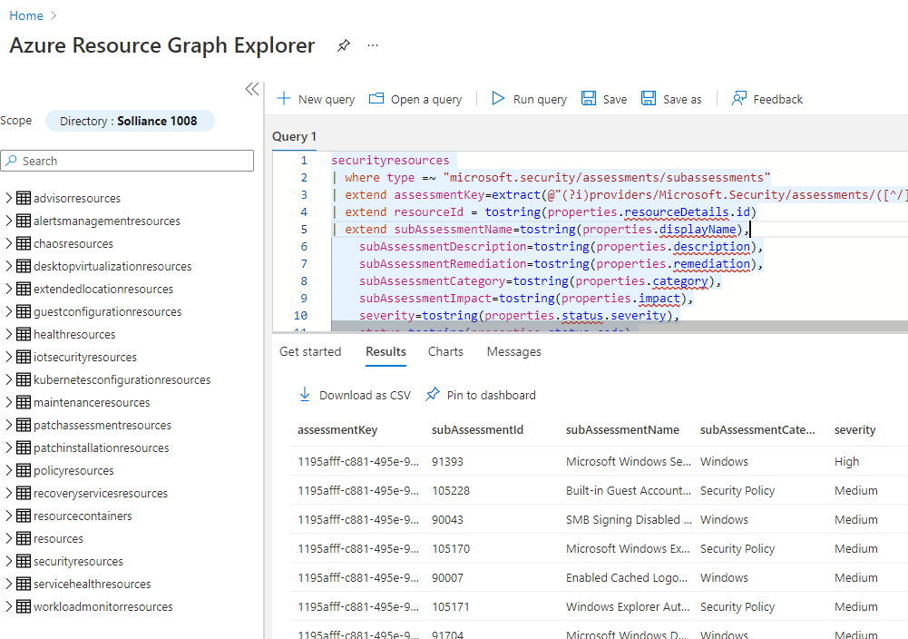
KQL
Use the securityresources table in Azure Resource Graph to query for VM Assessment data.
Assessmentkey: 1195afff-c881-495e-9bc5-1486211ae03f

Slide 41
Azure Policy
VM Vulnerability Assessments are not driven by Azure Policy.
Qualsys agent or Microsoft solution
Enablement is done via Azure Policy
You will be notified via Policy is you are missing a VM Assessment Solution

Slide 42
Manual Deployment
#get all vms
$vms = Get-AzVM
#deploy...
foreach($vm in $vms)
{
$res = Invoke-AzRestMethod -Path ('{0}/providers/Microsoft.Security/serverVulnerabilityAssessments/default?api-Version=2015-06-01-preview' -f $vm.id) -Method PUT
}
Notes:
https://github.com/Azure/Azure-Security-Center/blob/main/Remediation%20scripts/Enable%20the%20built-in%20vulnerability%20assessment%20solution%20on%20virtual%20machines%20(powered%20by%20Qualys)/PowerShell/qualys-remediate-unhealthy-vms.ps1

Slide 43
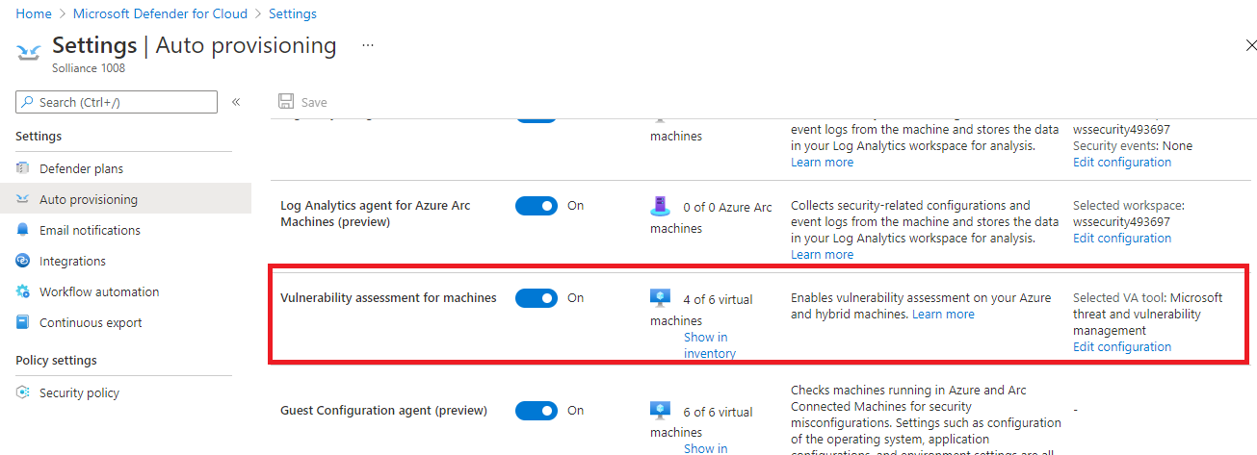
Auto-provisioning Deployment
Utilize Microsoft Defender for Cloud to auto-provision a VM Assessment solution:

Slide 44
SQL Vulnerability Assessments

Slide 45
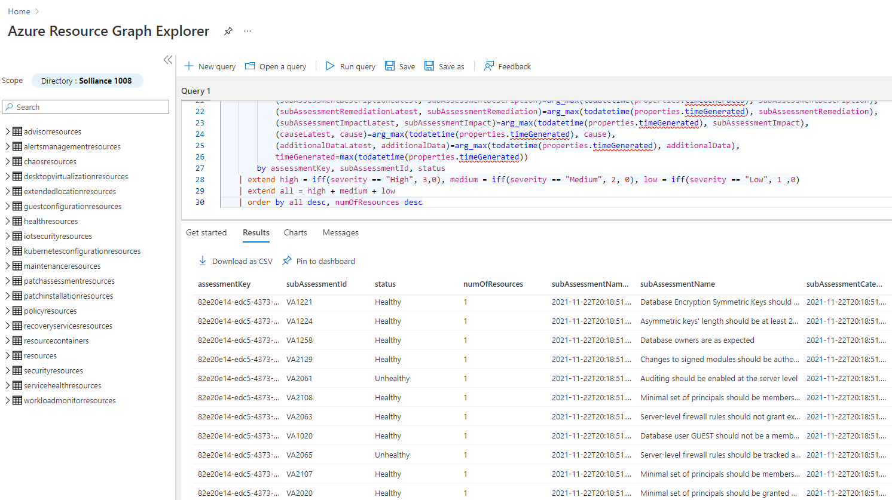
KQL
Use the securityresources table in Azure Resource Graph to query for VM Assessment data.
Assessmentkey: 82e20e14-edc5-4373-bfc4-f13121257c37

Slide 46
Azure Policy
SQL Vulnerability Assessments are not driven by Azure Policy.
Qualsys agent or Microsoft solution
Enablement is done via Azure Policy
You will be notified via Policy is you are missing a VM Assessment Solution

Slide 47
Manual Deployment
Get-AzSqlDatabase -ResourceGroupName "ResourceGroup01" -ServerName $"Server01" `
| where {$_.DatabaseName -ne "master"} `
| Update-AzSqlDatabaseVulnerabilityAssessmentSetting `
-StorageAccountName "mystorage" `
-ScanResultsContainerName "vulnerability-assessment" `
-RecurringScansInterval Weekly `
-EmailSubscriptionAdmins $true `
-NotificationEmail @("mail1@mail.com" , "mail2@mail.com")

Slide 48
Auto-provisioning Deployment
No Auto-provisioning available.

Slide 49
File Integrity

Slide 50
File Integrity
File integrity monitoring (FIM), also known as change monitoring, examines operating system files, Windows registries, application software, Linux system files, and more, for changes that might indicate an attack.
Microsoft Defender for Cloud recommends entities to monitor with FIM, and you can also define your own FIM policies or entities to monitor.
FIM alerts you for suspicious activity such as:
File and registry key creation or removal
File modifications (changes in file size, access control lists, and hash of the content)
Registry modifications (changes in size, access control lists, type, and the content)
FIM is only available from Microsoft Defender for Cloud's pages in the Azure portal. There is currently no REST API for working with FIM.

Slide 51
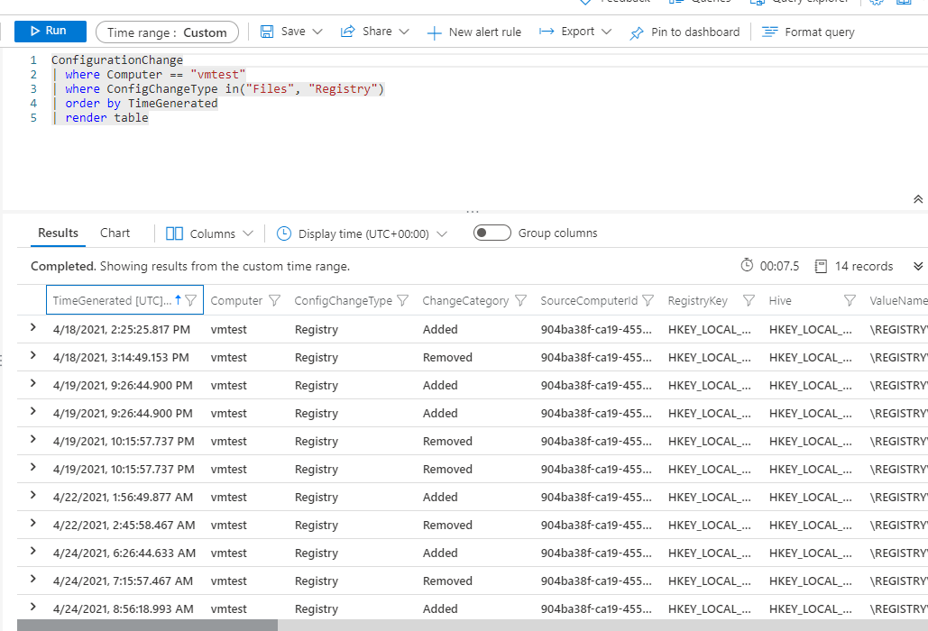
KQL
Use the ConfigurationChange table to query for FIM logs.

Slide 52
KQL – Common Queries
ConfigurationChange
| where TimeGenerated > ago(14d)
| where ConfigChangeType in ('Registry')
| order by Computer, RegistryKey
ConfigurationChange
| where TimeGenerated > ago(14d)
| where ConfigChangeType in ('Registry', 'Files')
| summarize count() by Computer, ConfigChangeType

Slide 53
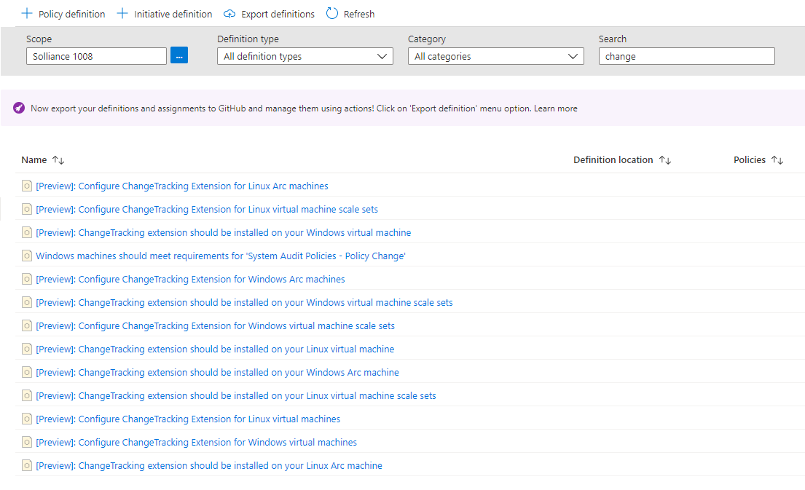
Azure Policy

Slide 54
Log Analytics Agent Deployment (Pre-req)
$PublicSettings = @{"workspaceId" = $workspaceId }
$ProtectedSettings = @{"workspaceKey" = $workspaceKey }
Set-AzVMExtension -ResourceGroupName $rg.ResourceGroupName -Location $vm.Location -VMName $vm.Name -Name "MicrosoftMonitoringAgent" -Publisher "Microsoft.EnterpriseCloud.Monitoring" -Type "Microsoft.EnterpriseCloud.Monitoring.MicrosoftMonitoringAgent" -TypeHandlerVersion "1.1" -Settings $PublicSettings -ProtectedSettings $ProtectedSettings;

Slide 55
Deployment (Change Tracking)
Easiest to do via Azure Portal or PowerShell.
Portal/ARM:
Azure Portal will create an ARM Template deployment package. Solutions are under Microsoft.OperationsManagement/solutions resource namespace
PowerShell:
$sol = “ChangeTracking”;
New-AzMonitorLogAnalyticsSolution -Type $sol -ResourceGroupName $rg.ResourceGroupName -Location $ws.Location -WorkspaceResourceId $ws.ResourceId

Slide 56
Container Image Scanning

Slide 57

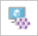

Container Protection
Kubernetes clusters - Continuous assessment of your clusters to provide visibility into misconfigurations and guidelines to help you mitigate identified threats.
Container hosts - Continuous assessment of your Docker environments to provide visibility into misconfigurations and guidelines to help you mitigate threats
Azure Container Registry (ACR) - Vulnerability assessment and management tools for the images in your Azure Resource Manager-based ACR registries

Slide 58
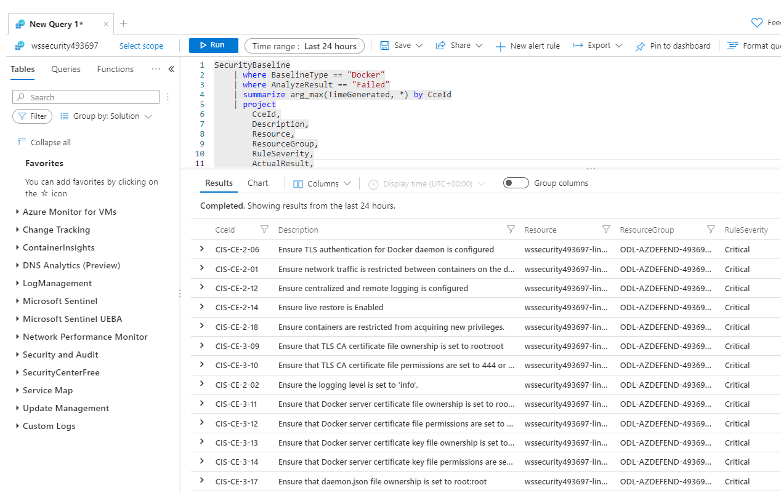
KQL
Use the SecurityBaseline table to query for container image scanning results.

Slide 59
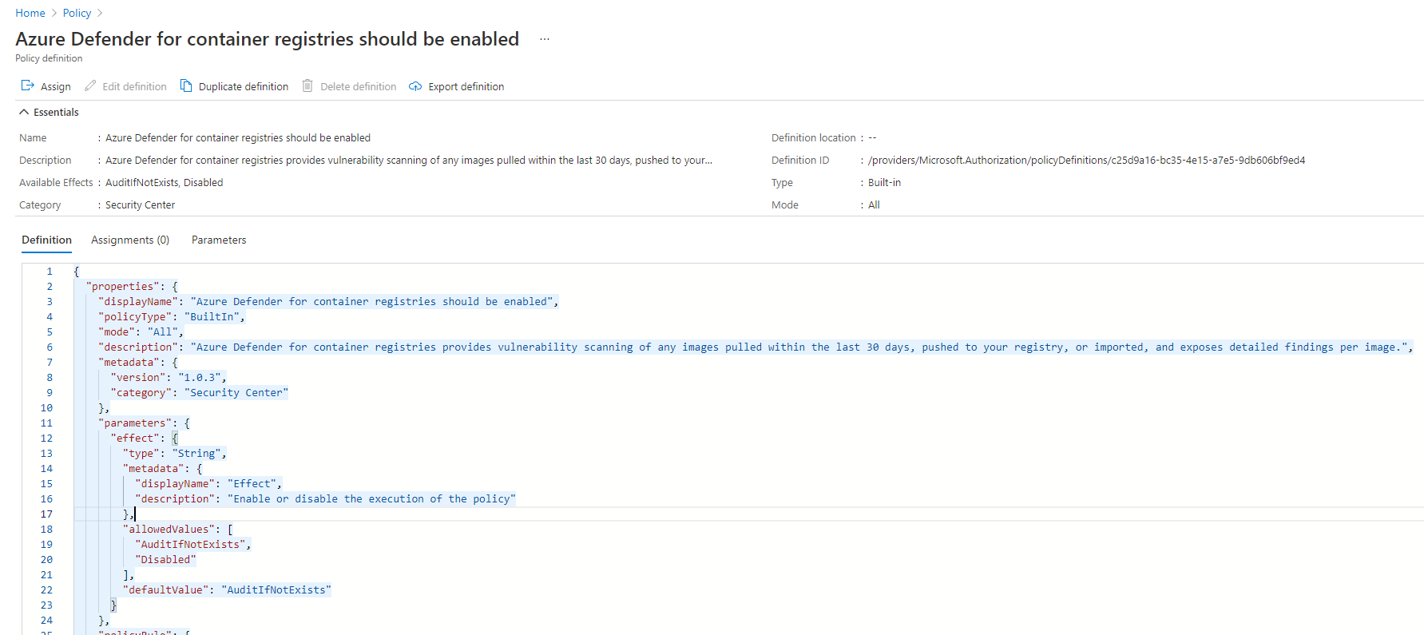
Azure Policy

Slide 60
Deployment (Container Insights)
Set-AzSecurityPricing -Name “ContainerRegistry” -PricingTier "Standard“
Easiest to do via Azure Portal or PowerShell.
Portal/ARM:
Azure Portal will create an ARM Template deployment package. Solutions are under Microsoft.OperationsManagement/solutions resource namespace
PowerShell:
$sol = “ContainerInsights”;
New-AzMonitorLogAnalyticsSolution -Type $sol -ResourceGroupName $rg.ResourceGroupName -Location $ws.Location -WorkspaceResourceId $ws.ResourceId

Slide 61
Adaptive Application Control
Notes:
Back to me

Slide 62
Adaptive Application Control
Intelligent and automated solution for defining allow lists of known-safe applications for your machines.
Uses machine learning to analyze the applications running on your machines and create a list of the known-safe software.
By defining lists of known-safe applications, and generating alerts when anything else is executed, you can achieve multiple hardening goals:
Identify potential malware, even any that might be missed by antimalware solutions
Improve compliance with local security policies that dictate the use of only licensed software
Avoid running old or unsupported applications
Prevent specific software that's banned by your organization
Increase oversight of apps that access sensitive data
Notes:
No enforcement options are currently available. Adaptive application controls are intended to provide security alerts if any application runs other than the ones you've defined as safe.

Slide 63
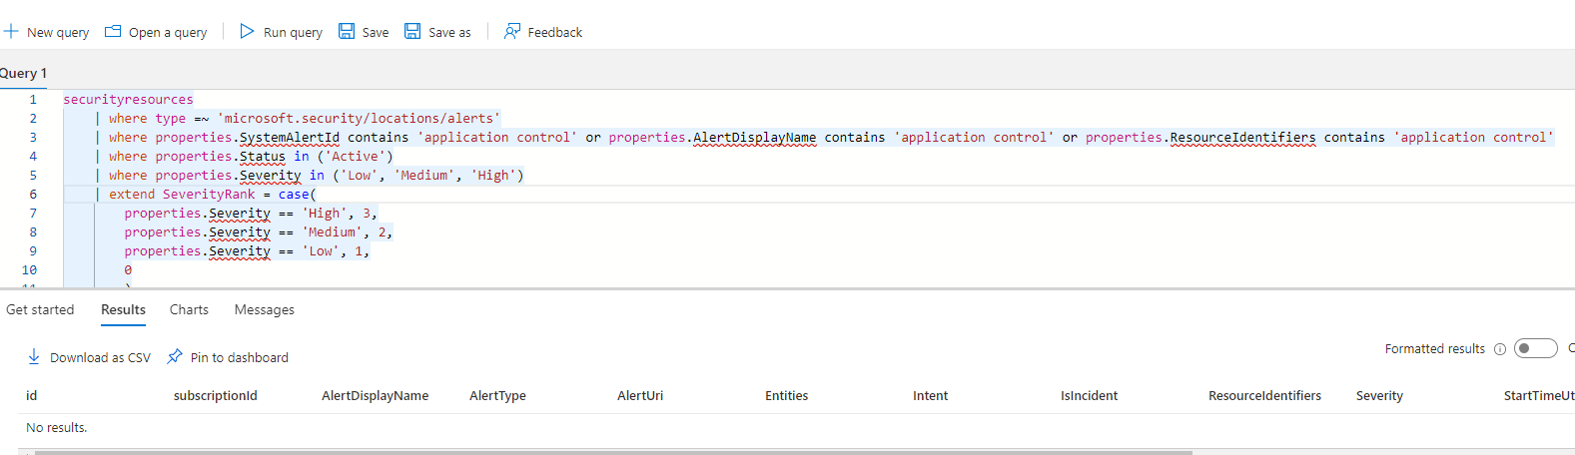
KQL
Use the SecurityResources table to query for Adaptive Application Control logs.

Slide 64
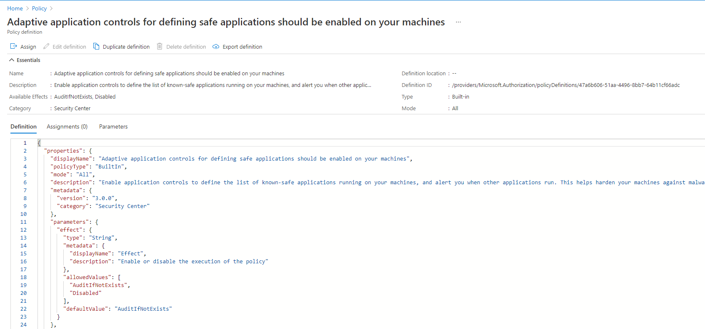
Azure Policy

Slide 65
Deployment
No deployment necessary. Enabled by default.

Slide 66
Adaptive Network Hardening
Notes:
Back to me

Slide 67
Adaptive Network Hardening
Adaptive network hardening is an agentless feature of Microsoft Defender for Cloud - nothing needs to be installed on your machines to benefit from this network hardening tool.
Provides recommendations to further harden NSG rules.
It uses a machine learning algorithm that factors in actual traffic, known trusted configuration, threat intelligence, and other indicators of compromise, and then provides recommendations to allow traffic only from specific IP/port tuples.
Adaptive network hardening recommendations are only supported on specific ports.
Notes:
Ports : 13, 17, 19, 22, 23, 53, 69, 81, 111, 119, 123, 135, 137, 138, 139, 161, 162, 389, 445, 512, 514, 593, 636, 873, 1433, 1434, 1900, 2049, 2301, 2323, 2381, 3268, 3306, 3389, 4333, 5353, 5432, 5555, 5800, 5900, 5900, 5985, 5986, 6379, 6379, 7000, 7001, 7199, 8081, 8089, 8545, 9042, 9160, 9300, 11211, 16379, 26379, 27017, 37215

Slide 68
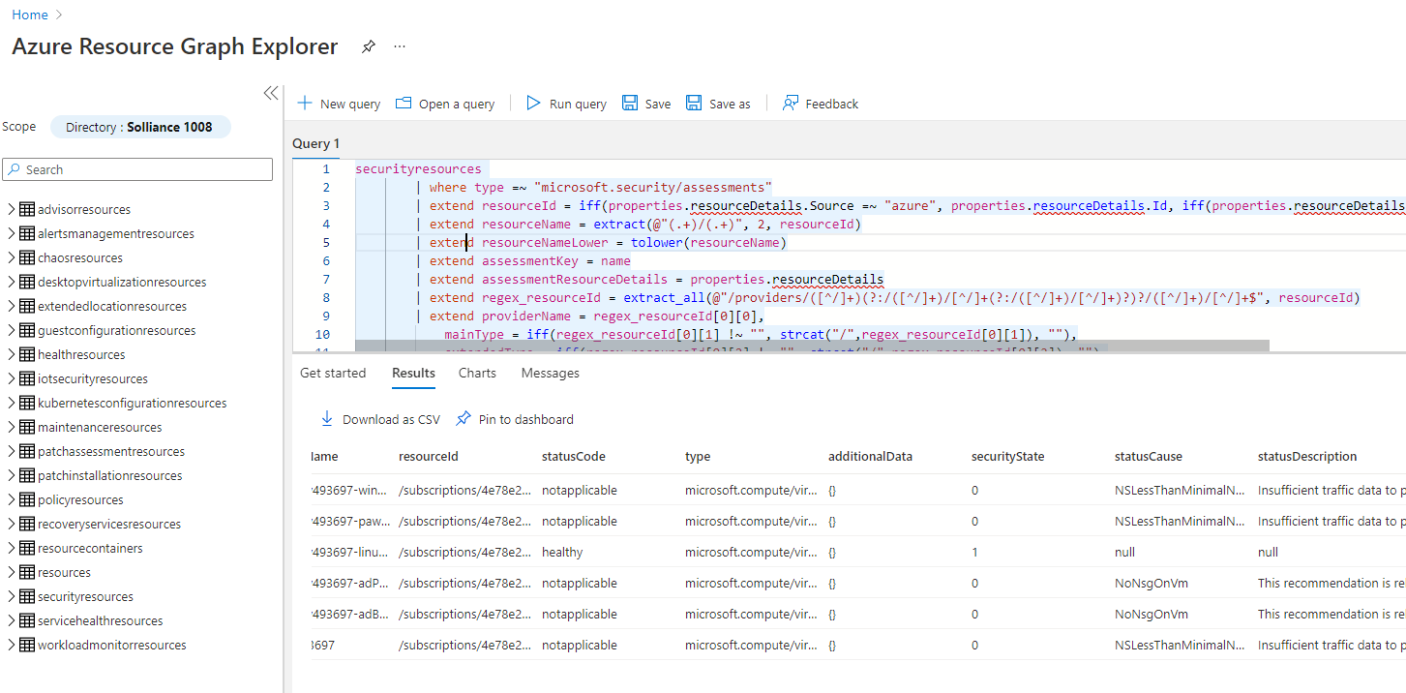
KQL
Use the SecurityResources table to query for network hardening logs.

Slide 69
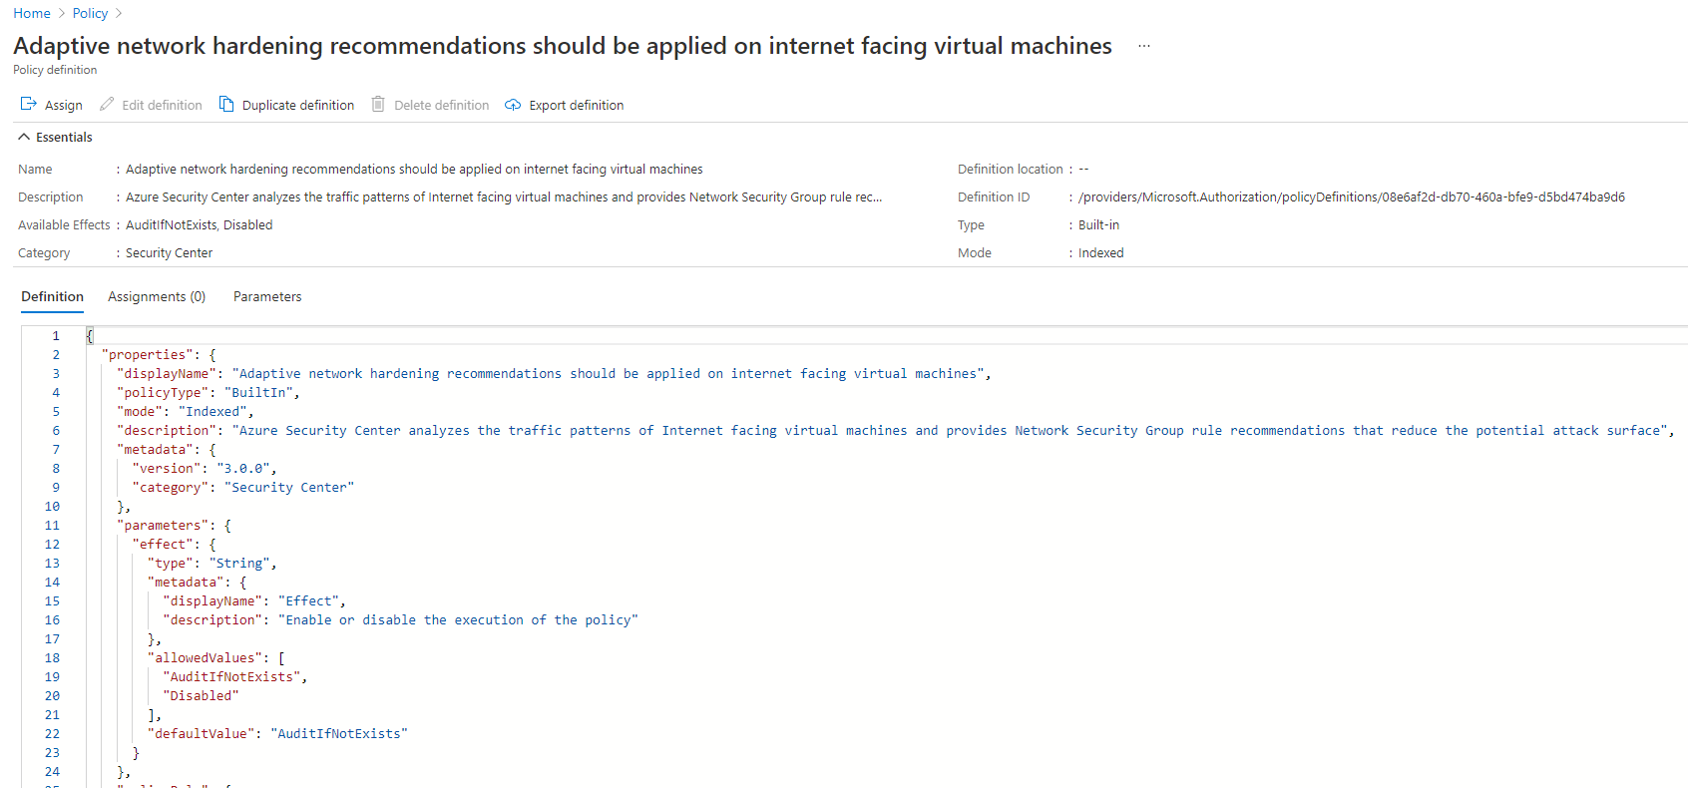
Azure Policy

Slide 70
Deployment
No deployment necessary. Enabled by default.
Internet facing resource + Network Security Group is required

Slide 71
Just In Time VM Access
Notes:
Back to me

Slide 72
JIT VM Access
Lock down inbound traffic to your Azure Virtual Machines with Microsoft Defender for Cloud's just-in-time (JIT) virtual machine (VM) access feature.
Select the ports on the VM to which inbound traffic will be blocked.
Ensures "deny all inbound traffic" rules exist for your selected ports in the network security group (NSG) and Azure Firewall rules.
When a user requests access to a VM, Microsoft Defender for Cloud checks that the user has Azure role-based access control (Azure RBAC) permissions for that VM.
If the request is approved, Microsoft Defender for Cloud configures the NSGs and Azure Firewall to allow inbound traffic to the selected ports from the relevant IP address (or range), for the amount of time that was specified
After the time has expired, Microsoft Defender for Cloud restores the NSGs to their previous states. Connections that are already established are not interrupted.

Slide 73
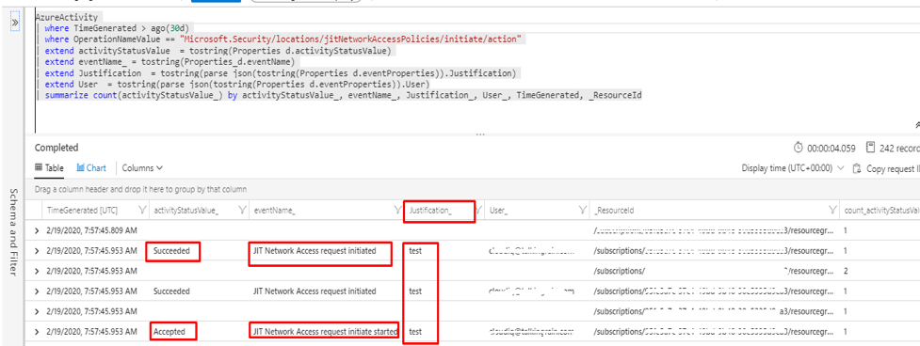
KQL
Use the AzureActivity table to query for JIT access logs.

Slide 74
KQL – Common Queries
AzureActivity
| where ResourceProviderValue =~ "Microsoft.Security"
| where OperationNameValue =~ "Microsoft.Security/locations/jitNetworkAccessPolicies/delete"
AzureActivity
| where TimeGenerated > ago(30d)
| where OperationNameValue == “Microsoft.Security/locations/jitNetworkAccessPolicies/initiate/action”
| extend activityStatusValue = toString(Properties d.activityStatusValue)
| extend eventName = toString(Properties d.eventName)
| extend Justification = toString(parse json(tostring(Properties d.eventProperties)).Justification)
| extend User = toString(parse json(tostring(Properties d.eventProperties)).User)
| summarize count(activityStatusValue) by activityStatusValue, eventName, Justification, User, TimeGenerated, ResourceId

Slide 75
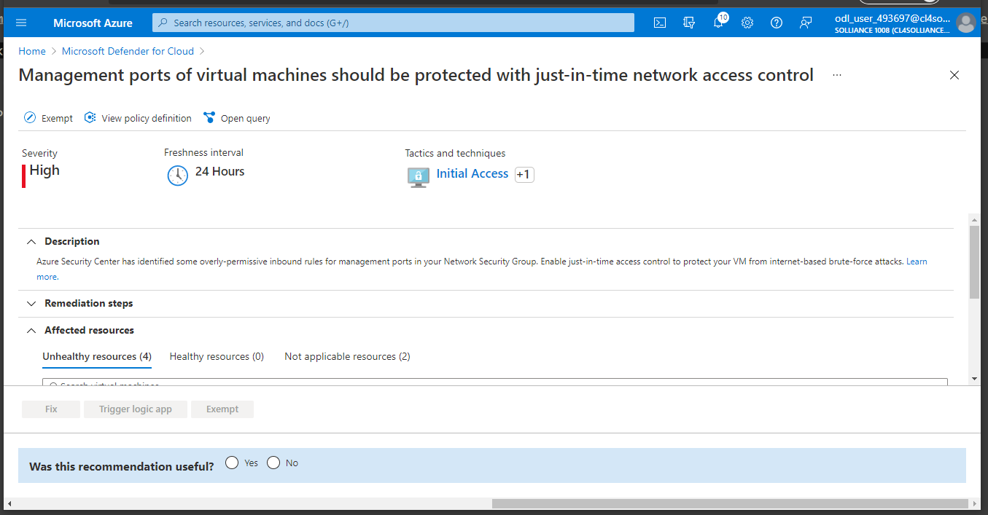
Azure Policy

Slide 76
Deployment
$JitPolicy = (@{ id="/subscriptions/$subscriptionId/resourceGroups/$($rg.ResourceGroupName)/providers/Microsoft.Compute/virtualMachines/$($vm.Name)"
ports=(@{
number=22;
protocol="*";
allowedSourceAddressPrefix=@("*");
maxRequestAccessDuration="PT3H"},
@{
number=3389;
protocol="*";
allowedSourceAddressPrefix=@("*");
maxRequestAccessDuration="PT3H"})})
$JitPolicyArr=@($JitPolicy)
Set-AzJitNetworkAccessPolicy -Kind "Basic" -Location $vm.Location -Name $vm.Name -ResourceGroupName $vm.ResourceGroupName -VirtualMachine $JitPolicyArr

Slide 77
Network Map
Notes:
Back to me

Slide 78
Network Map
Provides a graphical view with security overlays giving you recommendations and insights for hardening your network resources.
Using the map you can see the network topology of your Azure workloads, connections between your virtual machines and subnets, and the capability to drill down from the map into specific resources and the recommendations for those resources.
The network map can show you your Azure resources in a Topology view and a Traffic view.

Slide 79
KQL \ Rest Api
Network Map data is not available via KQL or Azure Resource Graph.
Data can be accessed via REST APIs
$url = "https://management.azure.com/subscriptions/$subscriptionId/providers/Microsoft.Security/topologies?includeResourceInformation=true&api-version=2015-06-01-preview"
$result = Invoke-RestMethod -Uri $url -Method Get -ContentType "application/json" -Headers @{"Authorization"="Bearer $managementToken"};
$result;
$url = "https://management.azure.com/subscriptions/$subscriptionId/providers/Microsoft.Security/allowedConnections?api-version=2015-06-01-preview";
$result = Invoke-RestMethod -Uri $url -Method Get -ContentType "application/json" -Headers @{"Authorization"="Bearer $managementToken"};

Slide 80
Deployment
No deployment necessary. Enabled by default.

Slide 81
Recommendations

Slide 82
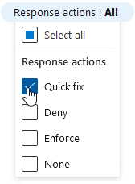
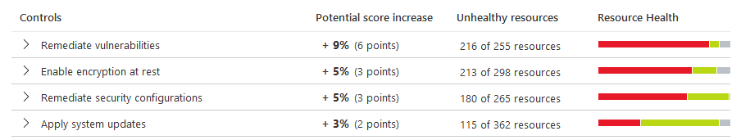
Recommendations
All of the previously discussed Microsoft Defender for Cloud solutions will evaluate either the control or data plane of Azure or non-Azure resources and generate security recommendations based on that particular resources best practices.
Recommendations give you suggestions on how to better secure your resources. You implement a recommendation by following the remediation steps provided in the recommendation.
Recommendations can have automation remediation tasks or require manual intervention, however the Fix feature is only available for specific recommendations.

Slide 83
Disable Recommendations
Occasionally, a resource will be listed that you feel shouldn't be included. Or a recommendation will show in a scope where you feel it doesn't belong.
Example: The resource might have been remediated by a process not tracked by Microsoft Defender for Cloud. The recommendation might be inappropriate for a specific subscription. Or perhaps your organization has simply decided to accept the risks related to the specific resource or recommendation.
Exempt a resource to ensure it isn't listed with the unhealthy resources in the future, and doesn't impact your secure score. The resource will be listed as not applicable and the reason will be shown as "exempted" with the specific justification you select.
Exempt a subscription or management group to ensure that the recommendation doesn't impact your secure score and won't be shown for the subscription or management group in the future. This relates to existing resources and any you create in the future. The recommendation will be marked with the specific justification you select for the scope that you selected.
Recommendations that are generated from any custom initiatives assigned to your subscriptions cannot be exempted
Notes:
https://docs.microsoft.com/en-us/azure/security-center/exempt-resource

Slide 84


Question…
Do preview recommendations render a resource unhealthy?
Are they calculated in your secure score?
Notes:
Preview recommendations don't render a resource unhealthy, and they aren't included in the calculations of your secure score.
Remediate them wherever possible, so that when the preview period ends they'll contribute towards your score.
Learn more about how to respond to these recommendations in Remediate recommendations in Azure Microsoft Defender for Cloud.

Slide 85
Question…
What could be the issue if you disable a policy recommendation at the subscription level yet the recommendations are still showing up?
Notes:
Remember that a management group applies its policies to its subscriptions.
Therefore, if you disable a subscription's policy, and the subscription belongs to a management group that still uses the same policy, then you will continue to receive the policy recommendations.
The policy will still be applied from the management level and the recommendations will still be generated.

Slide 86
Thank You slide
Break (15 mins)

Slide 87
Welcome Back!
Kick-Off | 8:00-8:05 | Welcome | Main Call
 | 8:05-8:30 | Microsoft Defender for Cloud + Microsoft Defender for Cloud
 | 8:30-8:45 | Demo Walkthrough
High-Level | 8:45-9:00 | Break
 | 9:00-10:00 | Microsoft Defender for Cloud, Defender, Arc, Lighthouse
 | 10:00-10:15 | Break
 | 10:15-11:15 | Microsoft Defender for Cloud Solutions
 | 11:15-12:00 | Activity: Microsoft Defender for Cloud Solutions | Table Group Call
Getting Technical | 12:00-1:00 | Long Break | Main Call
 | 1:00-1:30 | Azure Sentinel
 | 1:30-2:00 | Activity: Azure Sentinel | Table Group Call
 | 2:00-4:00 | Build Hands-on: Microsoft Defender for Cloud, Azure Sentinel | Table Group Call
 | 4:00-4:15 | Closing | Main Call
Presentation/
Whole Group
Lab
Activity/ Discussion/ Group Work
Announcements

Slide 88
DEMO: How to whiteboard designs

Slide 89
Breakout Activity: Microsoft Defender for Cloud
As a result of participating in this activity, you will better be able to Apply Microsoft Defender for Cloud features to a customer scenario
OUTCOMES
ACTIVITY
30 minutes
Learning Adviser
Table Group Channel
As a team review WWI requirements provided in student guide
Open the whiteboard and as a team answer the provided challenge questions.
The questions are pre-loaded into the whiteboard.
Welcome | Keynote | Demo Walkthrough | Break | Microsoft Defender for Cloud, Defender, Arc, Lighthouse | Break | Microsoft Defender for Cloud Solutions | Activity: Microsoft Defender for Cloud Solutions | Long Break | Azure Sentinel | Activity: Azure Sentinel | Lab: Microsoft Defender for Cloud, Azure Sentinel | Closing

Slide 90
Session and Lab Environment

Slide 91
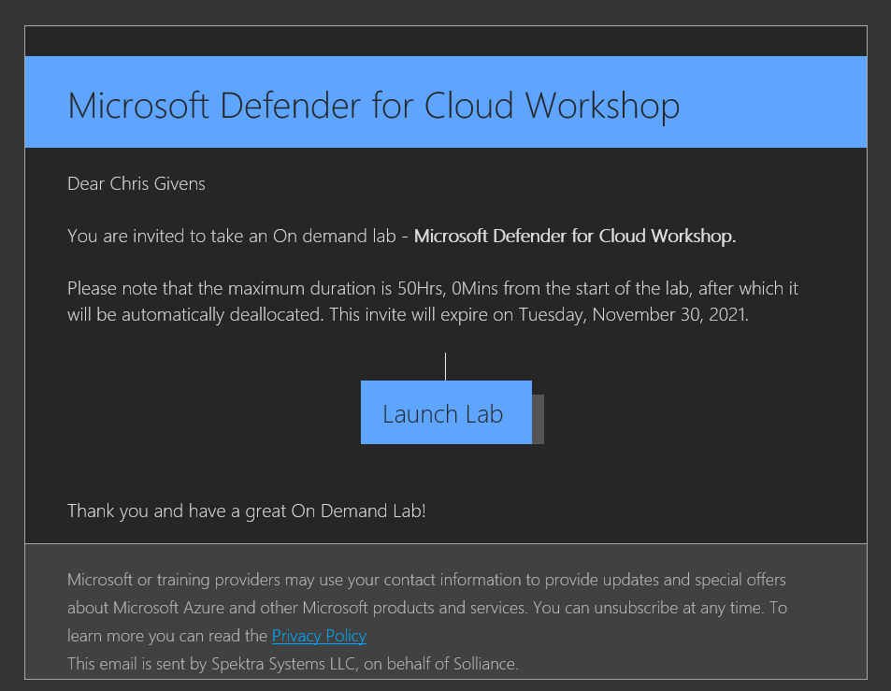
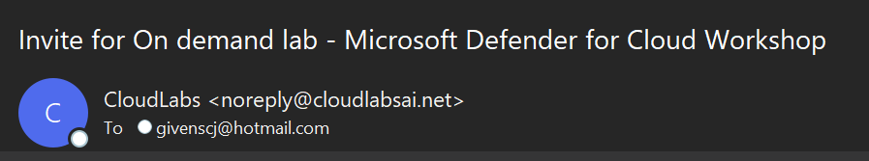
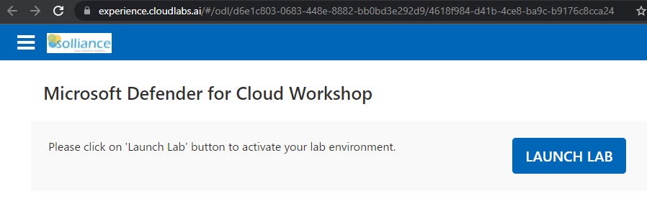
Use Bitly Link to Register

Slide 92
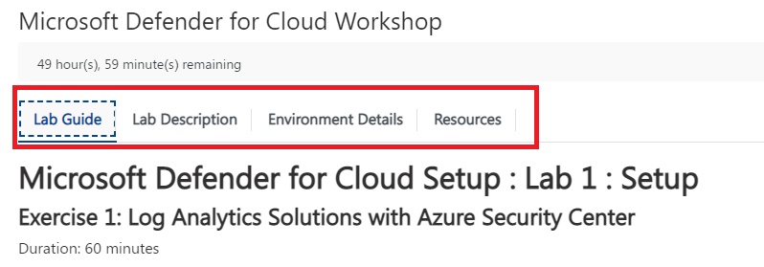
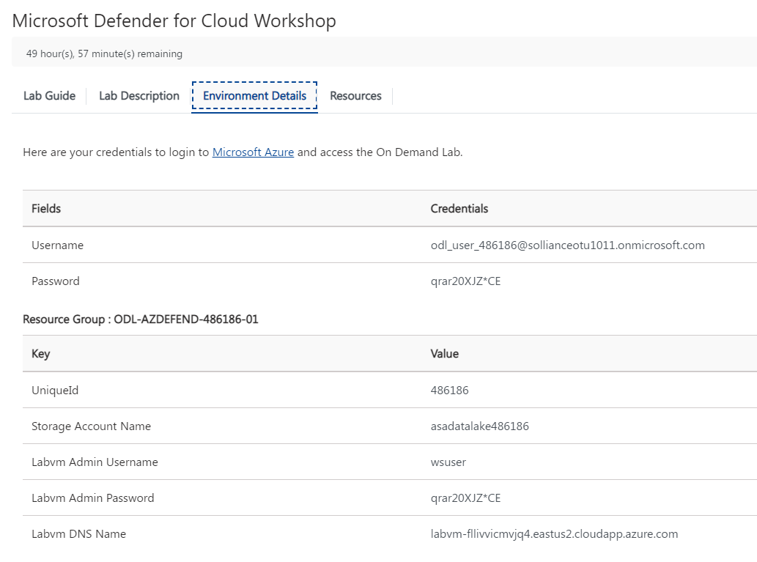
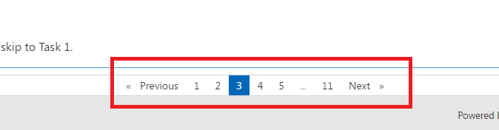
Lab Navigation

Slide 93
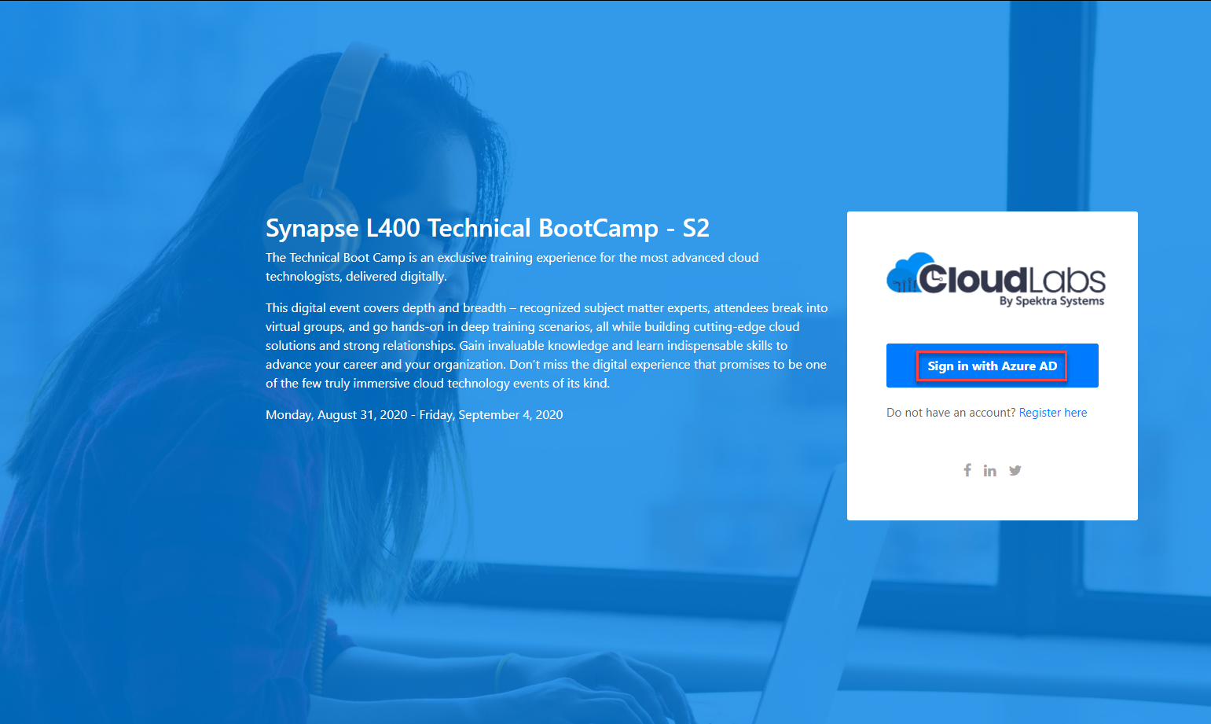
Login to the portal
Notes:
If they don’t have the emails.
Register link: https://bit.ly/32qwla3
Activation Code: ACTIVATE13799

Slide 94
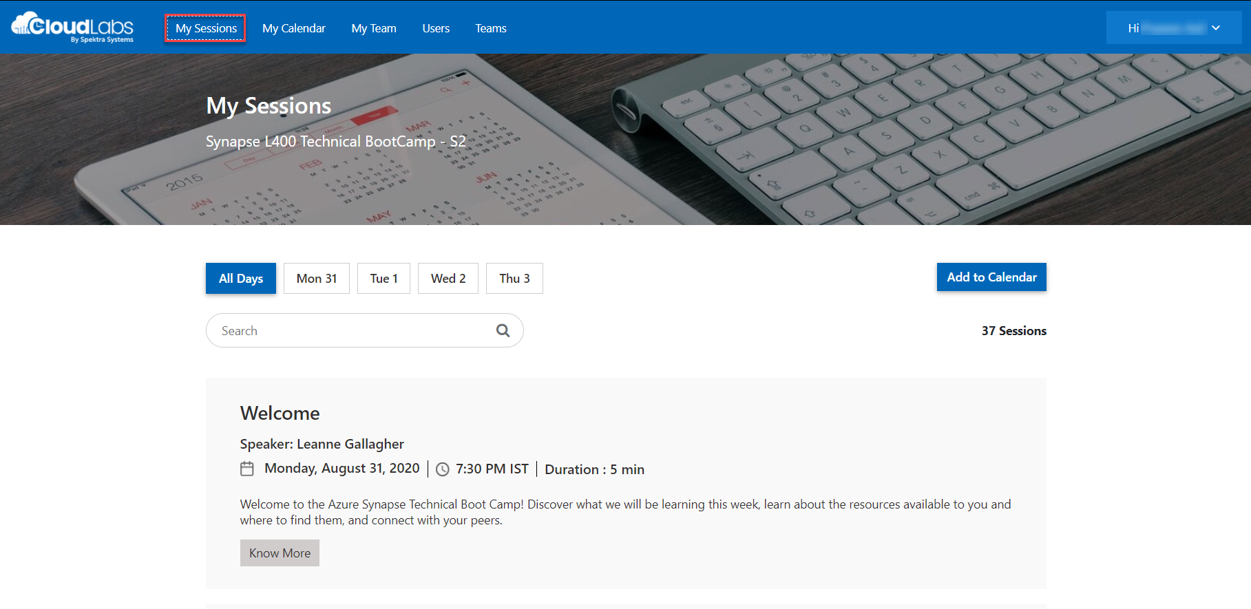
Sessions for Bootcamp

Slide 95
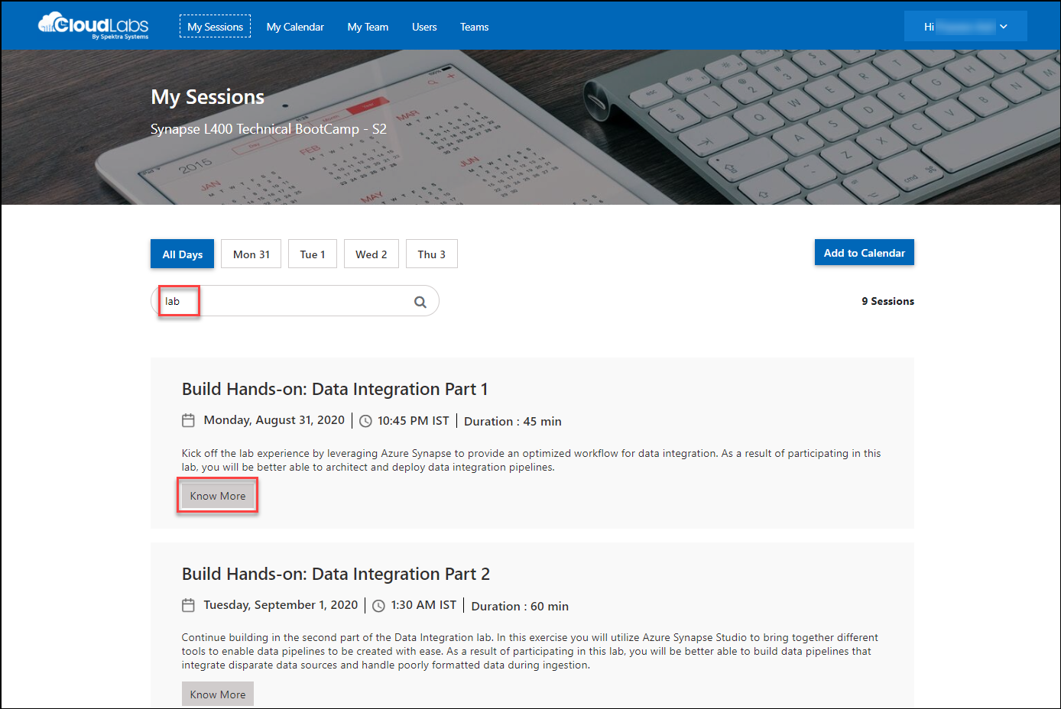
Search for lab
Search for lab
Click on Know More

Slide 96
DEMO: How to access your lab environment

Slide 97


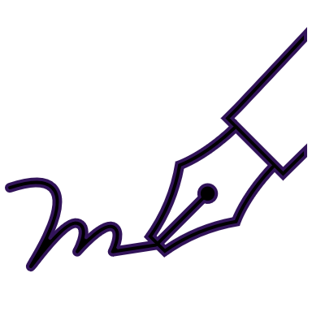






Lab: individual lab exercise
Step 1: Go to your table group channel
Step 2: Your Learning Adviser will provide you a unique cloud lab login link
Step 3: Login and begin the lab. Engage your table group via a Microsoft Teams “meet now” call to support each other (meet now button in upper right corner of application)

Slide 98
Build Hands-on Lab: Microsoft Defender for Cloud Part 1
As a result of participating in this lab, you will be better able to Setup + Deploy Microsoft Defender for Cloud protections
OUTCOMES
ACTIVITY
120 minutes
Independent
Table Group Channel & CloudLabs Environment
Independently review and complete Exercises 1-4 in the Lab 1 Guide.
Login to your CloudLabs environment and work through a set of tasks you would typically follow in work associated with ingesting and integrating your customer’s data.
The Lab Guide is available in the ‘Files’ tab of the General channel. Engage your Table Group call for support and troubleshooting.
Welcome | Keynote | Demo Walkthrough | Break | Data Loading & Data Lake Organization | Activity: Data Lake Design & Security Considerations | Break | Lab: Data Integration Part 1 | Break | Data Transformations | Activity: Data Engineering Discussion | Lab: Data Integration Part 2 | Closing

Slide 99
Thank You slide
Long Break (60 mins)

Slide 100
Welcome Back!
Kick-Off | 8:00-8:05 | Welcome | Main Call
 | 8:05-8:30 | Microsoft Defender for Cloud + Microsoft Defender for Cloud
 | 8:30-8:45 | Demo Walkthrough
High-Level | 8:45-9:00 | Break
 | 9:00-10:00 | Microsoft Defender for Cloud, Defender, Arc, Lighthouse
 | 10:00-10:15 | Break
 | 10:15-11:15 | Microsoft Defender for Cloud Solutions
 | 11:15-12:00 | Activity: Microsoft Defender for Cloud Solutions | Table Group Call
Getting Technical | 12:00-1:00 | Long Break | Main Call
 | 1:00-1:30 | Azure Sentinel
 | 1:30-2:15 | Activity: Azure Sentinel | Table Group Call
 | 2:15-4:00 | Build Hands-on: Microsoft Defender for Cloud, Azure Sentinel | Table Group Call
 | 4:00-4:15 | Closing | Main Call
Presentation/
Whole Group
Lab
Activity/ Discussion/ Group Work
Announcements

Slide 101
Microsoft Defender for Cloud APIs

Slide 102
Microsoft Defender for Cloud APIs
Microsoft Defender for Cloud APIs exists across several different REST endpoints.
Most are driven by the management.azure.com REST endpoint.
Some results must be accessed via the Azure Resource Graph API
https://docs.microsoft.com/en-us/rest/api/securitycenter/
Notes:
https://docs.microsoft.com/en-us/rest/api/securitycenter/

Slide 103
Azure Resource Graph
Azure Resource Graph is a service in Azure that is designed to extend Azure Resource Management by providing efficient and performant resource exploration with the ability to query at scale across a given set of subscriptions so that you can effectively govern your environment.
These queries provide the following features:
Ability to query resources with complex filtering, grouping, and sorting by resource properties.
Ability to iteratively explore resources based on governance requirements.
Ability to assess the impact of applying policies in a vast cloud environment.
Ability to detail changes made to resource properties (preview).

Slide 104
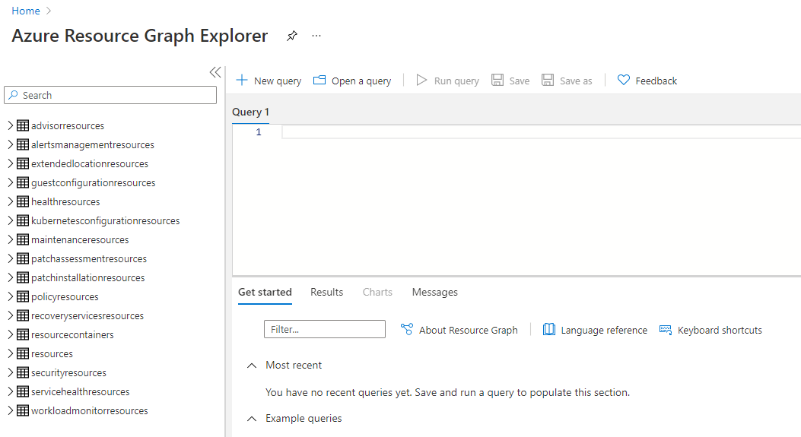
Resource Graph Explorer
Resource Graph Explorer provides browsable information about the Azure Resource Manager resource types and properties that you can query. Resource Graph Explorer also provides a clean interface for working with multiple queries, evaluating the results, and even converting the results of some queries into a chart that can be pinned to an Azure dashboard.

Slide 105
Resource Graph API
You can call the REST endpoint or utilize the Azure CLI to make Graph calls
REST:
POST https://management.azure.com/providers/Microsoft.ResourceGraph/resources?api-version=2019-04-01
{
"subscriptions": [
"{subscriptionID}"
],
"query": "Resources | project name, type | limit 5"
}
AZCLI: az graph <command>

Slide 106
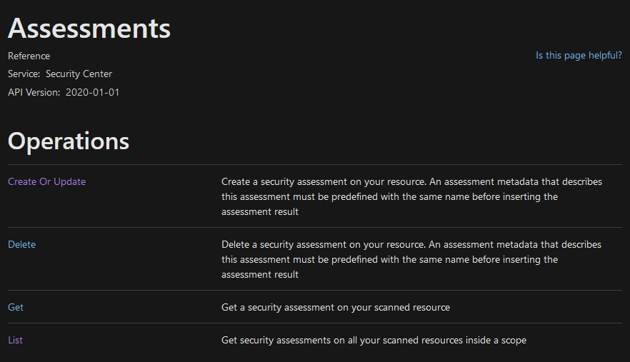
Assessments
Every query had an “Assessment” key, you can list these keys and then execute assessments via REST

Slide 107
Database Vulnerability Scans
Scans can be executed using the Azure Management API
https://docs.microsoft.com/en-us/rest/api/sql/2021-02-01-preview/database-vulnerability-assessment-scans
POST https://management.azure.com/subscriptions/{subscriptionId}/resourceGroups/{resourceGroupName}/providers/Microsoft.Sql/servers/{serverName}/databases/{databaseName}/vulnerabilityAssessments/default/scans/{scanId}/initiateScan?api-version=2021-02-01-preview
GET https://management.azure.com/subscriptions/{subscriptionId}/resourceGroups/{resourceGroupName}/providers/Microsoft.Sql/servers/{serverName}/vulnerabilityAssessments/default?api-version=2020-11-01-preview

Slide 108
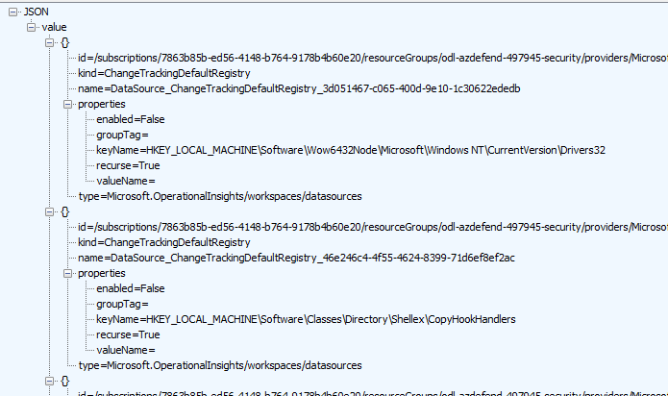
File Integrity
Utilize the Management APIs on the Log Analytics workspace “Datasources” endpoint:
GET https://management.azure.com/subscriptions/7863b85b-ed56-4148-b764-9178b4b60e20/resourceGroups/odl-azdefend-497945-security/providers/microsoft.operationalinsights/workspaces/wssecurity497945/datasources?$filter=kind+eq+%27ChangeTrackingDefaultRegistry%27&api-version=2015-11-01-preview&_=1638112478445

Slide 109
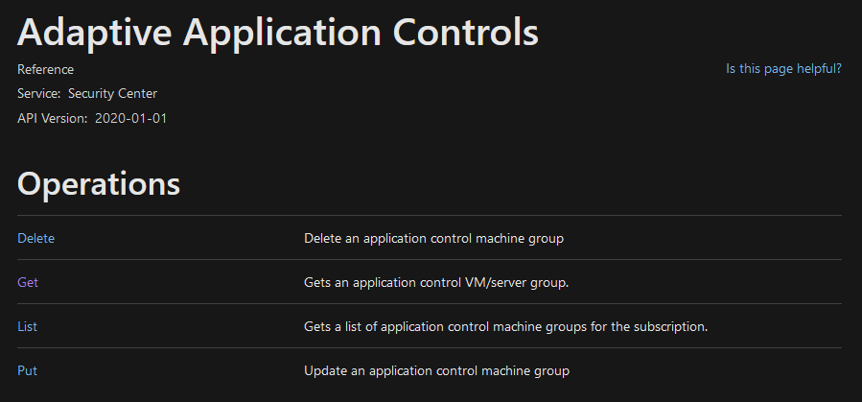
Adaptive Application Controls
Only simple CRUD operations:
https://docs.microsoft.com/en-us/rest/api/securitycenter/adaptive-application-controls

Slide 110

Adaptive Network Hardenings
Simple Get, List and Enforce operations:

Slide 111

Just In Time Access
Supports all CRUD operations for JIT Policies against virtual machines

Slide 112


Secure Score API
Three separate endpoints (Definitions, Controls and basic)

Slide 113
Recommendations API
Most Microsoft Defender for Cloud features will generate recommendations based on Policy definitions and assignments. These include:
Microsoft Defender for Cloud for Container Registries
Microsoft Defender for Cloud for Kubernetes
Microsoft Defender for Cloud for Storage
Microsoft Defender for Cloud for Key Vault

Slide 114

Alerts API
All alerts generated can be retrieved via REST API
https://docs.microsoft.com/en-us/rest/api/securitycenter/alerts

Slide 115

Authentication
Authentication is typically based on Azure AD authentication flows where a bearer token is generated and passed in the Authentication header.
Valid permission must exist for the principal to execute the actions in the API requests.

Slide 116
Versioning / Endpoints
Versioning of endpoints is done via the ApiVersion query string parameter.
It is very important that you call the right API version (whether the latest or a specifically targeted version) for your script/tool or your calls may fail.
Be careful with mixing and matching resource API versions. Some require specific versions in order to work properly.

Slide 117

Limits + Throttling
All REST API calls are throttled in some manner.
https://docs.microsoft.com/en-us/azure/azure-resource-manager/management/request-limits-and-throttling
Most REST APIs are implemented as Odata V4+
Use the $limit=999 in the query string
Reference the NextLink to loop through results.
Notes:
https://docs.microsoft.com/en-us/azure/azure-resource-manager/management/request-limits-and-throttling

Slide 118
Azure Sentinel

Slide 119

Azure Sentinel
Scalable, cloud-native, security information event management (SIEM) and security orchestration automated response (SOAR) solution. Azure Sentinel delivers intelligent security analytics and threat intelligence across the enterprise, providing a single solution for alert detection, threat visibility, proactive hunting, and threat response.
Azure Sentinel is your birds-eye view across the enterprise alleviating the stress of increasingly sophisticated attacks, increasing volumes of alerts, and long resolution time frames.
Notes:
TODO

Slide 120
The Concept of SIEM, SOAR and XDR
SIEMs are used for real-time security event analysis to help with investigation, early threat detection and incident response. They also support compliance use cases, as many data regulatory frameworks require organizations to keep audit logs for up to one year.
The key capabilities of SOAR solutions include threat management (help mitigate vulnerabilities), incident response (managing and coordinating response to a security incident) and security operations automation (overall orchestration of workflows, policy execution and reporting).
XDRs centralize normalized data, mostly focusing on products from their own ecosystem. They provide correlated data and alerts into security incidents, and they provide an incident response functionality that can be carried out via security policies.

Slide 121
Security Orchestration Automation and Response (SOAR)
SIEM/SOC teams are typically inundated with security alerts and incidents on a regular basis, at volumes so large that available personnel are overwhelmed.
This results all too often in situations where many alerts are ignored and many incidents aren't investigated, leaving the organization vulnerable to attacks that go unnoticed.
Azure Sentinel, in addition to being a Security Information and Event Management (SIEM) system, is also a platform for Security Orchestration, Automation, and Response (SOAR).
One of its primary purposes is to automate any recurring and predictable enrichment, response, and remediation tasks that are the responsibility of your Security Operations Center and personnel (SOC/SecOps), freeing up time and resources for more in-depth investigation of, and hunting for, advanced threats.
Notes:
TODO

Slide 122
Why Sentinel?
#1 - Better value for money
Help lower business overheads related to security posture almost immediately after adoption because of its scalable, fully managed nature.
#2 - Seamless security integrations.
Office 365, Log Analytics, Cloud App Security, Palo Alto, ServiceNow, SumoLogic, etc
#3 - Meets the needs for both IT Security and decision-makers
Security teams can get alerts in real time, remediate problems more efficiently using ML and AI-enhanced automation, and use query language for more proactive identification of threats and anomalies.
Business leaders can access relevant data across the business using Azure Sentinel’s visualized and interactive dashboards, which saves time having to source reports from different departments
Notes:
TODO

Slide 123


Slide 124


Slide 125





Latest innovations
Helping you stay ahead of threats
Analytics
Behavioral Analytics (UEBA) Entity Search and Profiles New ML Fusion Scenarios
Jupyter Notebooks Powered by Azure ML
Intelligence
Threat Indicator Management Integrated Threat Intelligence from Threat
Quotent, Recorded Future, RiskIQ
Watchlists
Data Collection
Network Schema (OSSEM) Logstash Output Plug-In
Connectors for: Microsoft Teams, Microsoft 365 Defender Endpoint, CyberArk, NetScaler, ForgeRock, & Beyond Security

Slide 126






End-to-end solution for security operations
Detect
Collect
Visibility
Investigate
Incidents
Respond
Automation
Analytics
Hunting
Powered by community + backed by Microsoft’s security experts

Slide 127


Azure Sentinel vs Microsoft Defender for Cloud
Cybersecurity Cycle
Visibility
Analytics
Hunting
Incidents
Automation
Microsoft Defender for Cloud
Azure Sentinel

Slide 128
Azure Sentinel
Things that you can NOT do:
You can NOT use the same Log Analytics Workspace that is used by Microsoft Defender for Cloud
Once Azure Sentinel is enabled on a workspace, you can NOT move the workspace to another resource group or subscription (you have to contact Azure Sentinel Support Team to accomplish this task)
Notes:
TODO

Slide 129

Azure Sentinel - Connectors
Over 100+ Data Connectors available for Azure Sentinel
Not only for Azure connection but external services as well.
Notes:
TODO

Slide 130

Azure Sentinel - Connectors
Example: Azure Active Directory Connector:
Notes:
TODO

Slide 131

Azure Sentinel - Connectors
Example: Security Events Connector:
Notes:
TODO

Slide 132

Azure Sentinel - Connectors
Example: Office 365

Slide 133


Logging - Focus on what’s important

Slide 134
Azure Sentinel - Incidents
Azure Sentinel incidents are containers of threats in your organization – alerts, entities and any additional related evidence.
An incident is created based on alerts that you have defined in the security analytics page. The properties related to the alerts, such as severity and status are set at the incident level.
Activities related to events include:
View related alerts - View all related alerts that are aggregated into an incident based on the alert trigger definition of the alert fusion strategy enabled
Triage and investigate - Review all related entities in the incident and additional contextual information meaningful to the triage process.
Incident Management - Manage the lifecycle of the incident – assign to yourself for further investigation, change the status of the incident and update its severity after triage.
Respond to alerts - Trigger playbooks on the alerts grouped in the incident to resolve the threat detected by the alert using playbooks.
Notes:
TODO

Slide 135
Question…
What is the maximum number of alerts an Azure Sentinel Incident can contain?
Notes:
Incidents in Azure Sentinel can contain a maximum of 150 alerts. Microsoft 365 Defender incidents can have more than this. If a Microsoft 365 Defender incident with more than 150 alerts is synchronized to Azure Sentinel, the Sentinel incident will show as having “150+” alerts and will provide a link to the parallel incident in Microsoft 365 Defender where you will see the full set of alerts.
https://docs.microsoft.com/en-us/azure/sentinel/microsoft-365-defender-sentinel-integration?view=o365-worldwide

Slide 136

Azure Sentinel - Workbooks
Azure Sentinel integrates with Azure Monitor Workbooks
You can create Workbooks across your Data
Azure Sentinel comes with Workbook templates to allow for quick insight gain right after connecting the data.
Notes:
TODO

Slide 137

Azure Sentinel - Hunting
Over 195 pre-defined queries helpful for hunting for potential threats in your log data
Defined based on the MITRE ATTACK framework tactics and techniques
Keeps track of deltas (previous results)
Queries should not have time defined in the KQL query
Livestream allows for a user session-based, user interface driven feature that allows an Azure Sentinel user to quickly create a Livestream session using any Log Analytics query.
Test newly created queries, elevate to alerts once tested
Allows for quick testing without custom alert rule overhead
Target an entity for live streaming during an investigation
https://github.com/Azure/Azure-Sentinel/tree/master/Hunting%20Queries
Notes:
https://docs.microsoft.com/en-us/azure/sentinel/hunting
https://github.com/Azure/Azure-Sentinel/tree/master/Hunting%20Queries

Slide 138

Hunting Queries
Over 195 pre-defined hunting queries curated by Microsoft security experts.
Azure Sentinel’s Hunting Queries is a differentiation point as compared to other SIEM solutions.
These queries help in the migration process as they reduce some of the work of migrating source queries.

Slide 139

Azure Sentinel - Notebooks
Julia Python and R ➔ Jupyter Notebooks
When to use Notebooks in Sentinel?
When triaging an incident in Azure Sentinel comes to a dead end.
Your investigation become significantly more complex
When automation ends and there is a need to find a needle in a haystack
Too much details to go through
Need persistence to pass results to the next analyst
KQL is no longer cutting it
Need to integrate with external data (WhoIs, GeoIP, etc…) not stored in the workspace
Need for ML and visualizations available already in the form of 1000s of libraries and packages.
Notes:
Notebooks in Azure Sentinel are based on Jupyter notebooks based on Julia Python and R languages.

Slide 140


Azure Sentinel – Notebooks …
You can use Visual Studio Code to develop your Notebooks.
You can use a Local Docker Container to developer locally disconnected.
You can use %kql as a magic command to continue using your queries in the notebooks

Slide 141

Azure Sentinel – Notebooks …

Slide 142

Azure Sentinel – Notebooks …
Notes:
Choosing the ML Template Notebook to use with Azure Sentinel
You have to choose a Compute to start using the Notebook
You will need to Authenticate from the notebook to use any Azure SDK

Slide 143

Azure Sentinel – Entity Behavior
Notes:
TODO

Slide 144

Azure Sentinel – Entity Behavior – Use Cases
Notes:
TODO

Slide 145


Slide 146
Question…
Can you install Azure Sentinel on the default workspace created by Microsoft Defender for Cloud?
Notes:
Default workspaces created by Microsoft Defender for Cloud will not appear in the list; you can't install Azure Sentinel on them.
https://docs.microsoft.com/en-us/azure/sentinel/quickstart-onboard?view=o365-worldwide

Slide 147


Slide 148


Slide 149


Slide 150
Azure Sentinel – Threat Intelligence
Azure Sentinel lets you import the threat indicators your organization is using, which can enhance your security analysts' ability to detect and prioritize known threats.
You can stream threat indicators to Azure Sentinel by using one of the integrated threat intelligence platform (TIP) products, connecting to TAXII servers, or by using direct integration with the Microsoft Graph Security tiIndicators API.
Mitre Attack Framework utilize STIX and TAXII feeds to import data.
Notes:
TODO

Slide 151
Microsoft Graph - tiIndicator
The Microsoft Graph Security API tiIndicators entity allows you to upload your threat indicators to Microsoft security tools for the actions of allow, block, or alert.
TargetProduct can be Azure Sentinel or Microsoft Defender
Limit of 15000 indicators per tenant
The following indicator types are supported:
Files
IP addresses: Microsoft Defender ATP supports destination IPv4/IPv6 only – set property in networkDestinationIPv4 or networkDestinationIPv6 properties
URLs/domains
Notes:
https://docs.microsoft.com/en-us/graph/api/resources/tiindicator?view=graph-rest-beta

Slide 152


Threat Intelligence Storage
Once imported, Threat Intelligence data is stored in Log Analytics and can be queried:
Notes:
https://docs.microsoft.com/en-us/graph/api/resources/tiindicator?view=graph-rest-beta

Slide 153

Azure Sentinel – Analytics
Azure Sentinel provides out-of-the-box, built-in templates to help you create threat detection rules.
These templates were designed by Microsoft's team of security experts and analysts based on known threats, common attack vectors, and suspicious activity escalation chains.
Rules created from these templates will automatically search across your environment for any activity that looks suspicious.
Many of the templates can be customized to search for activities, or filter them out, according to your needs.
The alerts generated by these rules will create incidents that you can assign and investigate in your environment.
Notes:
TODO

Slide 154

Azure Sentinel – Fusion
Based on Fusion technology, advanced multistage attack detection in Azure Sentinel uses scalable machine learning algorithms that can correlate many low-fidelity alerts and events across multiple products into high-fidelity and actionable incidents.
Notes:
https://docs.microsoft.com/en-us/azure/sentinel/tutorial-detect-threats-built-in?WT.mc_id=Portal-Microsoft_Azure_Security_Insights

Slide 155

How Fusion Works - Construct graph
Fusion gathers all the low and medium level alerts detected in a 30-day window and creates a graph.
The graph is hyperconnected and consists of billions of vertices and edges. Each entity is represented by a vertex (or node).
For example, a vertex could be a user, an IP address, a virtual machine (VM), or any other entity within the network. The edges (or links) represent all the activities. If a user accesses company resources with a mobile device, both the device and the user are represented as vertices connected by an edge.
Notes:
https://www.microsoft.com/security/blog/2020/02/20/azure-sentinel-uncovers-real-threats-hidden-billions-low-fidelity-signals/

Slide 156
How Fusion Works – Kill Chain
Fusion applies a probabilistic kill chain which acts as a regularizer to the graph.
The statistical analysis is based on how real people—Microsoft security experts, vendors, and customers—triage alerts.
For example, defenders prioritize kill chains that are time bound. If a kill chain is executed within a day, it will take precedence over one that is enacted over a few days. An even higher priority kill chain is one in which all steps have been completed.
This intelligence is encoded into the Fusion machine learning statistical model. Once the probabilistic kill chain is applied, Fusion outputs a smaller number of sub graphs, reducing the number of threats from billions to hundreds.
Notes:
https://www.microsoft.com/security/blog/2020/02/20/azure-sentinel-uncovers-real-threats-hidden-billions-low-fidelity-signals/

Slide 157
How Fusion Works – Score Attack
To reduce the noise further, Fusion uses machine learning to apply a final round of scoring. If labeled data exists, Fusion uses random forests. Labeled data for attacks is generated from the extensive Azure red team that execute these scenarios. If labeled data doesn’t exist Fusion uses spectral clustering.
Some of the criteria used to elevate threats include the number of high impact activity in the graph and whether the subgraph connects to another subgraph.
The output of this machine learning process is tens of threats. These are extremely high priority alerts that require immediate action. Without Fusion, these alerts would likely remain hidden from view, since they can only be seen after two or more low level threats are stitched together to shine a light on stealth activities. AI-generated alerts can now be handed off to people who will determine how to respond.
Notes:
https://www.microsoft.com/security/blog/2020/02/20/azure-sentinel-uncovers-real-threats-hidden-billions-low-fidelity-signals/

Slide 158
Azure Sentinel – Fusion
Fusion is enabled by default.
Because the logic is hidden and therefore not customizable, you can only create one rule with this template.
Fusion engine can correlate alerts produced by scheduled analytics rules with those from other systems, producing high-fidelity incidents as a result. Total of 90 Fusion incident types detected, which require specific connectors to be enabled.
By creating and enabling any rules based on the ML behavior analytics templates, you give Microsoft permission to copy ingested data outside of your Azure Sentinel workspace's geography as necessary for processing by the machine learning engines and models.
Notes:
https://docs.microsoft.com/en-us/azure/sentinel/tutorial-detect-threats-built-in?WT.mc_id=Portal-Microsoft_Azure_Security_Insights

Slide 159
Question…
How many days of historical data does Fusion machine learning utilize?
How is the data encrypted?
Notes:
Azure Sentinel currently uses 30 days of historical data to train the machine learning systems.
This data is always encrypted using Microsoft’s keys as it passes through the machine learning pipeline.
However, the training data is not encrypted using Customer Managed Keys (CMK) if you enabled CMK in your Azure Sentinel workspace.
To opt out of Fusion, navigate to Azure Sentinel &gt; Configuration &gt; Analytics &gt; Active rules &gt; Advanced Multistage Attack Detection and in the Status column, select Disable.
As the machine learning algorithm requires 30 days' worth of data to build a baseline profile of user behavior, you must allow 30 days of Windows Security events data to be collected before any incidents can be detected.
https://docs.microsoft.com/en-us/azure/sentinel/fusion?view=o365-worldwide

Slide 160
Azure Sentinel – Anomaly
Inevitably attacks should result in unusual behavior in the systems being attacked.
Azure Sentinel's SOC-ML machine learning-based anomalies can identify this behavior with analytics rule templates. Anomaly rule templates use SOC-ML (machine learning) to detect specific types of anomalous behavior.
Anomalies can be powerful tools, but they are notoriously very noisy. They typically require a lot of tedious tuning for specific environments or complex post-processing.
Azure Sentinel SOC-ML anomaly templates are tuned by our data science team to provide out-of-the box value, but should you need to tune them further, the process is simple and requires no knowledge of machine learning.
Each rule has its own unique parameters and thresholds, appropriate to the behavior being analyzed.
While its configuration can't be changed or fine-tuned, you can duplicate the rule, change and fine-tune the duplicate, run the duplicate in Flighting mode and the original concurrently in Production mode, compare results, and switch the duplicate to Production if and when its fine-tuning is to your liking.
Notes:
https://docs.microsoft.com/en-us/azure/sentinel/tutorial-detect-threats-built-in?WT.mc_id=Portal-Microsoft_Azure_Security_Insights
https://docs.microsoft.com/en-us/azure/sentinel/soc-ml-anomalies

Slide 161

Azure Sentinel – Scheduled
Scheduled analytics rules are based on built-in queries written by Microsoft security experts. You can see the query logic and make changes to it. You can use the scheduled rules template and customize the query logic and scheduling settings to create new rules.
Rule scheduling options include configuring the rule to run every specified number of minutes, hours, or days, with the clock starting when you enable the rule.
We recommend being mindful of when you enable a new or edited analytics rule to ensure that the rules will get the new stack of incidents in time.
For example, you might want to run a rule in synch with when your SOC analysts begin their workday, and enable the rules then.
Notes:
https://docs.microsoft.com/en-us/azure/sentinel/tutorial-detect-threats-built-in?WT.mc_id=Portal-Microsoft_Azure_Security_Insights
You can easily export your rule to an Azure Resource Manager (ARM) template if you want to manage and deploy your rules as code. You can also import rules from template files in order to view and edit them in the user interface.

Slide 162
Azure Sentinel – Watchlist
Azure Sentinel watchlists enable the collection of data from external data sources for correlation with the events in your Azure Sentinel environment.
Once created, you can use watchlists in your search, detection rules, threat hunting, and response playbooks.
Watchlists are stored in your Azure Sentinel workspace as name-value pairs and are cached for optimal query performance and low latency. Use for:
Investigating threats. Responding to incidents quickly with the rapid import of IP addresses, file hashes, and other data from CSV files.
Importing business data as a watchlist. For example, import user lists with privileged system access, or terminated employees, and then use the watchlist to create allow and deny lists used to detect or prevent those users from logging in to the network.
Reducing alert fatigue. Create allow lists to suppress alerts from a group of users, such as users from authorized IP addresses that perform tasks that would normally trigger the alert, and prevent benign events from becoming alerts.
Enriching event data. Use watchlists to enrich your event data with name-value combinations derived from external data sources.
Notes:
TODO

Slide 163
Azure Sentinel – Automation
Automation rules allow you to centrally manage all the automation of incident handling.
Automation rules streamline automation use in Azure Sentinel and enable you to simplify complex workflows for your incident orchestration processes.
Automation rules are triggered by the creation of incidents.
You can set conditions to govern when actions will run, based on the incident and entity details and on analytics rules. You can also set the order of actions and the rule’s expiration time.
Use Automation Rules to:
Automate incident configuration - Directly set incident status or severity, assign an owner, or add a tag when an incident is created, without the need for running a playbook.
Trigger playbooks for Microsoft Providers - Automate the handling of Microsoft security alerts by applying rules to incidents created from the alerts.
Run playbooks on incidents - You can still run playbooks from your automation rules to integrate with other services or create complex logic chains. The rules pass the incidents to playbooks with all their details, including alerts and entities.
Apply incident suppression - You can use rules to automatically resolve incidents that are known false/benign positives – for example, when running penetration tests, doing scheduled maintenance or upgrades, or testing automation procedures.
Notes:
TODO

Slide 164
Azure Sentinel – Solutions
Azure Sentinel solutions provide in-product discoverability, single-step deployment, and enablement of end-to-end product, domain, and/or vertical scenarios in Azure Sentinel.
This experience is powered by Azure Marketplace for solutions’ discoverability, deployment, and enablement, and by Microsoft Partner Center for solutions’ authoring and publishing.
Customers can easily discover packaged content and integrations that deliver value for a product, domain, or vertical within Azure Sentinel.
Customers can easily deploy content in a single step, and optionally enable content to get started immediately.
Providers or partners can deliver combined product or domain or vertical value using solutions in Azure Sentinel, and also be able to productize investments.
https://docs.microsoft.com/en-us/azure/sentinel/sentinel-solutions
https://docs.microsoft.com/en-us/azure/sentinel/sentinel-solutions-deploy
Notes:
https://docs.microsoft.com/en-us/azure/sentinel/sentinel-solutions
https://docs.microsoft.com/en-us/azure/sentinel/sentinel-solutions-deploy
https://techcommunity.microsoft.com/t5/azure-sentinel/introducing-azure-sentinel-solutions/ba-p/2347312

Slide 165
Azure Sentinel – SIEM Integration
Enrich the insights you get with Azure Sentinel by bringing in alerts from your current SIEM.
Azure Sentinel’s built-in machine learning models can help reduce the false positives you’re seeing in your current SIEM, and enable your security team focus on only the alerts that matter.
You can connect your existing SIEM to Azure Sentinel in two ways:
If your current SIEM uses CEF for alerts or events, Azure Sentinel has a native CEF connector
If you are using a log forwarder, utilize the Logstash connector for Log Analytics to forward logs to Azure Sentinel
If your team is more comfortable working within your existing SIEM, Microsoft Security Graph API can serve to connect Azure Sentinel to your current toolset.
Security Graph API allows you to integrate Microsoft alerts into numerous 3rd party tools, including other SIEMs.
Notes:
https://techcommunity.microsoft.com/t5/azure-sentinel/try-azure-sentinel-alongside-your-existing-siem/ba-p/912965

Slide 166


Slide 167

Azure Sentinel – Community
Open source community (https://github.com/Azure/Azure-Sentinel) to facilitate collaboration among customers and partners using GitHub. ​ Explore sample content for alert rules, Add-ons, playbooks and more.
Join the Azure Sentinel community to interact with other customers and experts to learn, provide feedback and share knowledge about Azure Sentinel.
Notes:
TODO

Slide 168
Question…
Where is data stored (geo-location) for an Azure Sentinel instance?
Notes:
Data will be stored in the geographic location of the Log Analytics workspace on which you are running Azure Sentinel.
https://docs.microsoft.com/en-us/azure/sentinel/connect-vmware-carbon-black?view=o365-worldwide

Slide 169
Migrating to Sentinel

Slide 170
Migration to Azure Sentinel
Azure Sentinel is redefined on-premises and cloud security.
With its market leading SIEM and SOAR capabilities, customers are exploring the possibilities it provides.
One barrier to adoption is the migration of their current SIEM to Azure Sentinel.
Companies have invested heavily into current SIEM and Security Solutions with both time, money and staff skills.
Migrating to Azure Sentinel can present many different challenges.
Examples : Splunk, QRadar, ArcSight

Slide 171
Evaluating a SIEM
Customer’s should evaluate moving to a new SIEM based on the following:
Attack detection coverage : Compare how well each SIEM is able to detect the full range of attacks using MITRE ATT&CK or a similar framework.
Responsiveness : Measure the mean time to acknowledge (MTTA), which is the time between when an alert appeared in the SIEM and when the analyst first started working on it. This will likely be similar between any SIEMs.
Mean time to remediate (MTTR) : Compare incidents investigated by each SIEM (with analystsat an equivalent skill level).
***Hunting speed and agility : Measure how fast your teams can hunt—starting from a fully formed hypothesis, to querying the data, to getting the results on each SIEM platform.
Capacity growth friction : Compare the level of difficulty in adding capacity as your cloud use grows. This is particularly important because cloud services and applications tend to generate more log data than traditional on-premises workloads.

Slide 172
It’s Inevitable - Side by side operation
There are several models you can choose from to approach the side-by-side phase of the migration process.
Moving logs from Azure Sentinel to your legacy SIEM (not recommended)
Moving logs from your legacy SIEM to Azure Sentinel (not recommended)
Using Azure Sentinel and your legacy SIEM side by side, as two separate panes of glass. (not recommended)
Sending alerts from Azure Sentinel to your existing SIEM, typically using Azure Sentinel to analyze your cloud data sources. (not optimal)
Sending alerts from your existing SIEM to Azure Sentinel. (recommended)
Notes:
https://azure.microsoft.com/mediahandler/files/resourcefiles/azure-sentinel-migration-fundamentals/Azure%20Sentinel%20Migration%20Fundamentals.pdf

Slide 173
Migration Considerations
Things to consider when discussion with customers:
Data Sources / Logs
Custom Fields and Mappings
Native / Custom Connectors
Search Queries
Detection Rules
Remediation Actions (Cloud vs On-Premises)
Workbooks / Dashboard / Reports
Users and Permissions

Slide 174
Migrating Data Sources
Migration is a prime opportunity to re-evaluate your security needs and cull content that’s no longer useful.
This is especially important when dealing with a SIEM, where the amount of data ingested has a cost implication for your business.
Begin by prioritizing your data sources.
Is this data source valuable?
Identify any lingering gaps in visibility from your legacy SIEM and determine how you can close them.

Slide 175
Migrating Detection Rules
Rule migration across SIEMs requires a clear strategy and a detailed implementation plan to achieve your business goals while reducing security risks.
When planning your detection migration, create checklists and important points to consider before you begin the rule-migration steps.
Also, include useful resources to help prepare your team for the journey.
Because Azure Sentinel uses ML analytics to produce high-fidelity and actionable incidents, it’s likely that some of your existing detections won’t be required anymore.
Don’t migrate all the rules blindly; focus on quality, not quantity

Slide 176

Detection Rules
Rule migration across SIEMs is not a trivial task. It requires a clear strategy and a detailed implementation plan to achieve business goals while reducing the security risk of not having enough detection coverage.
Notes:
https://techcommunity.microsoft.com/t5/azure-sentinel/best-practices-for-migrating-detection-rules-from-arcsight/ba-p/2216417

Slide 177

Rule Migration Steps – 3rd Party SIEM
3rd Party SIEM Steps:
Identity Data Sources
Identify attributes / fields / entities used
Identify rule criteria / logic
Identity Trigger Criteria
Identify Rule Actions

Slide 178

Rule Migration Steps – Azure Sentinel
Azure Sentinel Steps:
Construct KQL and test with data
Create the analytics rules
Test with use cases
Create playbooks for actions

Slide 179

Migration Process Flow

Slide 180

Example: Splunk
Artifacts that can be exported from Splunk include:
Alerts
Alert Actions
Source Types
Reports
Searches
Dashboard
Users & Permissions
All accessible for export via a REST API from the Splunk server.
You must convert all objects to their corresponding components in Azure Sentinel.

Slide 181


Example: Splunk Side by Side
Use Azure Sentinel connector to send alert data to Sentinel
Notes:
https://techcommunity.microsoft.com/t5/azure-sentinel/how-to-export-data-from-splunk-to-azure-sentinel/ba-p/1891237

Slide 182
Exporting Artifacts
Be careful exporting artifacts from a customers SIEM environment.
Some queries may have sensitive information contained in them.
Watch out for remediation actions that may contain username and passwords.

Slide 183

Uncoder.io
SOC Prime’s online conversion tool for SIEM search language.
Uncoder.io can convert rules in Sigma or queries from other SIEMs to Azure Sentinel without the need to access the SIEM. Be careful with sharing queries that may have sensitive information in them.

Slide 184
Final Checklist
Check critical data: Make sure sources and alerts are available in Azure Sentinel.
Archive all records: Save critical records of past incidents and cases (raw data optional) to retain institutional history.
Playbooks: Update investigation and hunting processes for Azure Sentinel.
Metrics: Ensure that all key metrics can be obtained completely from Azure Sentinel. Create custom workbooks, or use built-in workbook templates to quickly gain insights as soon as you connect to data sources.
Cases: Make sure all current cases are transferred to the new system (including required source data).
SOC analysts: Make sure everyone on your team is trained on Azure Sentinel and feels comfortable leaving the legacy SIEM.

Slide 185
Azure Sentinel APIs

Slide 186

Azure Sentinel APIs
We can categorize Azure Sentinel APIs as follows:
Azure Sentinel Management API
Microsoft Graph Security API
Log Analytics API
HTTP Data Collector API
Notes:
TODO

Slide 187

Sentinel Management API
Azure Sentinel REST APIs allow you to create and manage data connectors, analytic rules, incidents, bookmarks and get entity information - https://github.com/Azure/azure-rest-api-specs/tree/master/specification/securityinsights/resource-manager/Microsoft.SecurityInsights
Notes:
https://docs.microsoft.com/en-us/rest/api/securityinsights/
https://github.com/Azure/azure-rest-api-specs/tree/master/specification/securityinsights/resource-manager/Microsoft.SecurityInsights

Slide 188

Microsoft Graph Security API
Microsoft Graph Security API uses
GET security alerts.
POST security alerts.
Ingest TI into Sentinel.

Slide 189

Log Analytics API
Log Analytics API uses
GET / POST data stored in a Log Analytics workspace
As well as call rate limits and daily quota caps, there are also limits on queries themselves:
Queries cannot return more than 500,000 rows
Queries cannot return more than 64,000,000 bytes (~61 MiB total data)
Queries cannot run longer than 10 minutes by default. See this for details.

Slide 190

HTTP Data Collector API
You can use the HTTP Data Collector API to send log data to a Log Analytics from any client that can call a REST API.
There are some constraints around the data posted to the HTTP Data Collector API.
Maximum of 30 MB per post to Azure Monitor Data Collector API. This is a size limit for a single post. If the data from a single post that exceeds 30 MB, you should split the data up to smaller sized chunks and send them concurrently.
Maximum of 32 KB limit for field values. If the field value is greater than 32 KB, the data will be truncated.
Recommended maximum number of fields for a given type is 50. This is a practical limit from a usability and search experience perspective.
A table in a Log Analytics workspace only supports up to 500 columns (referred to as a field in this article).
The maximum number of characters for the column name is 500.

Slide 191
Azure Sentinel – Case Studies

Slide 192

Case Studies - First West Credit Union
In fact, the security and operations team spent almost three months just moving Office 365 logs into ArcSight. It required another year and a half of work to have the SIEM running with about 80 percent of the organization’s logs from across its Azure, Microsoft 365, and on-premises solutions.
“We could onboard our logs from Azure and Office 365 in literally one click”
Using the playbook capabilities in Azure Sentinel to develop automated responses to security alerts or investigations that use Azure Logic Apps to perform actions across various security solutions.
First West uses Azure Sentinel in conjunction with its service desk ticketing solution, ServiceNow, and other third-party systems using Azure Logic Apps.
Notes:
https://customers.microsoft.com/en-us/story/790006-first-west-credit-union-banking-and-capital-markets-azure-sentinel

Slide 193

Case Studies - ASOS
Using Azure Sentinel, ASOS has created a bird’s-eye view of everything it needs to spot threats early, allowing it to proactively safeguard its business and its customers. As a result, it has cut issue resolution times in half.
“We use Azure Sentinel to gain a bird’s-eye view of everything. We now have a lot more data connections, a far better view of all incidents, and security processes that are more efficient and effective.”
“With everything running through Azure Sentinel, we’ve reduced the time spent on case management and resolution of alerts by approximately 50 percent”

Slide 194
Azure Sentinel PoC
Get Customer’s trying out Azure Sentinel Today!
Sentinel All-In-One : https://github.com/javiersoriano/sentinel-all-in-one
Azure Sentinel All in One is a project that seeks to speed up deployment and initial configuration tasks of an Azure Sentinel environment. This is ideal for Proof of Concept scenarios and connector onboarding when highly privileged users are needed.

Slide 195
Breakout Activity: Azure Sentinel
As a result of participating in this activity, you will better be able to Plan, design and migrate an existing SIEM to Azure Sentinel
OUTCOMES
ACTIVITY
30 minutes
Learning Adviser
Table Group Channel
As a team review WWI requirements provided in student guide
Open the whiteboard and as a team answer the provided challenge questions.
The questions are pre-loaded into the whiteboard.
Welcome | Keynote | Demo Walkthrough | Break | Microsoft Defender for Cloud, Defender, Arc, Lighthouse | Break | Microsoft Defender for Cloud Solutions | Activity: Microsoft Defender for Cloud Solutions | Long Break | Azure Sentinel | Activity: Azure Sentinel | Lab: Microsoft Defender for Cloud, Azure Sentinel | Closing

Slide 196
Build Hands-on Lab: Microsoft Defender for Cloud Part 2
As a result of participating in this lab, you will be better able to Microsoft Defender for Cloud REST APIs
OUTCOMES
ACTIVITY
30 minutes
Independent
Table Group Channel & CloudLabs Environment
Independently review and complete Exercises 1-4 in the Lab 1 Guide.
Login to your CloudLabs environment and work through a set of tasks you would typically follow in work associated with ingesting and integrating your customer’s data.
The Lab Guide is available in the ‘Files’ tab of the General channel. Engage your Table Group call for support and troubleshooting.
Welcome | Keynote | Demo Walkthrough | Break | Data Loading & Data Lake Organization | Activity: Data Lake Design & Security Considerations | Break | Lab: Data Integration Part 1 | Break | Data Transformations | Activity: Data Engineering Discussion | Lab: Data Integration Part 2 | Closing

Slide 197
Build Hands-on Lab: Azure Sentinel
As a result of participating in this lab, you will be better able to Setup Azure Sentinel
OUTCOMES
ACTIVITY
60 minutes
Independent
Table Group Channel & CloudLabs Environment
Independently review and complete Exercises 1-4 in the Lab 1 Guide.
Login to your CloudLabs environment and work through a set of tasks you would typically follow in work associated with ingesting and integrating your customer’s data.
The Lab Guide is available in the ‘Files’ tab of the General channel. Engage your Table Group call for support and troubleshooting.
Welcome | Keynote | Demo Walkthrough | Break | Data Loading & Data Lake Organization | Activity: Data Lake Design & Security Considerations | Break | Lab: Data Integration Part 1 | Break | Data Transformations | Activity: Data Engineering Discussion | Lab: Data Integration Part 2 | Closing

Slide 198
Q + A

Slide 199

Full Group Activity: Microsoft Defender for Cloud + Azure Sentinel
Objective: As a result of participating in this activity, you will better be able to answer various questions about the products.
What you will be doing: The facilitator will be posting questions to the entire group using an interactive tool called Mentimeter. The answers you post using Mentimeter will then drive the discussion.
Total Activity Time: 15 minutes

Slide 200

Mentimeter Poll
Scan QR Code
or Go to www.menti.com and use code
1183 9575
Notes:
https://www.menti.com/9r2wwujwag

Slide 201
Closing
Thank you for your participation in today’s Azure Synapse Technical Boot Camp!
We learned:
Microsoft Defender for Cloud, Azure Arc, Azure Lighthouse
Microsoft Defender for Cloud Solutions
Azure Sentinel
TODAY
We will learn to:
Log Analytics
Azure Automation
Security Operations Center (SOC)
TOMORROW

Slide 202
Thank You slide
Thank you

